Slide 1
Epic Heroism
What makes someone EPIC?

Slide 2
Epic Tradition
An epic is a long narrative poem. At the center of all epics is the epic hero.
Epic heroes are the first heroes of literature.
All epic heroes, despite their origin, have FOUR main characteristics:
Go on a long and treacherous journey
Encounter larger than life creatures and struggles on that journey
Display larger than life characteristics to defeat those creatures and struggles
Embody the morals and values of the society of their society

Slide 3
Epic Hero Characteristics
Go on a long and treacherous journey
Star Wars Example:
All epic heroes must JOURNEY somehow and somewhere
The journey is a physical journey that teaches moral and emotional lessons along the way.
Star Wars physical example: Luke takes a physical journey throughout space to become a Jedi and to defeat the Empire (there is literal travel involved). During that journey he learns about himself, his family, his past, his beliefs, etc.

Slide 4
Epic Hero Characteristics
Encounters larger than life creatures and struggle
Star Wars Example:
While on their journey the hero must face monsters and hardships. These creatures and internal struggles are a representation of the ills and problems of the society the hero comes from.
Darth Vadar: Darth Vadar represents the evil and dark tendencies within all people. Just as Luke does, humanity must learn to face that darkness, accept it, and overcome it.

Slide 5
Epic Hero Characteristics
Displays larger than life characteristic to defeat the creatures and struggles
Star Wars example:
For each monster the hero faces, they must display a heroic trait that is larger than life (meaning not achievable by a normal person). This trait is a highly valued idea or moral in the society from which the hero comes.
Defeat of the Empire: American culture loves to root for the little guy. The Resistance is tiny and much less powerful than the Empire, but through determination, belief in their abilities, and team work, they are able to defeat the Empire.

Slide 6
Epic Hero Characteristics
Embody the morals and values of their society
Star Wars example:
For each creature of struggle they face, the epic hero displays qualities that represent the ideology of their society. By the end of the epic, the hero displays all of the qualities that the society believes a good person should have.
Over the course of the original three, Luke displays the characteristics of a good American person. He is generous, kind, puts others before self, sacrifices when necessary, loves and protects his family and friends, and fights for freedom from oppression.

Slide 7
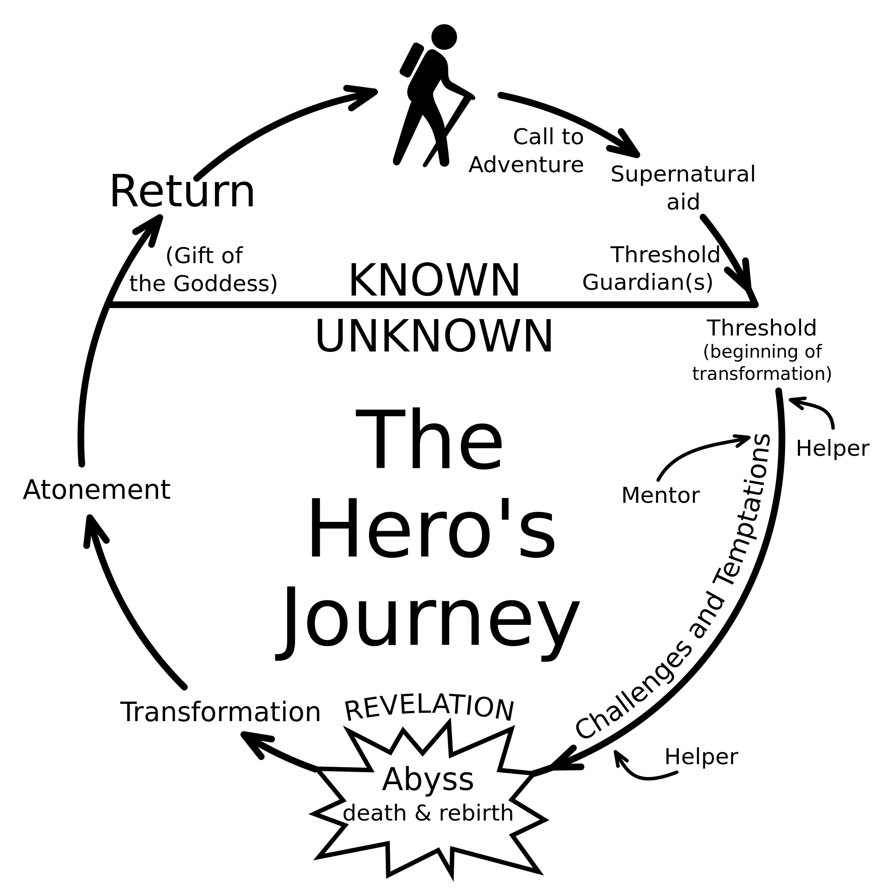
Monomyth
Leaving Tatooine
Defeating the Empire; returning triumphant
Most epics also follow the conventions of the monomyth.
The Force
Fights with Storm Troopers
Journey to find Yoda
Fighting against his father; watching him die
Yoda
C3P0, R2D2
Learning to be a Jedi; learning about the Resistance
Embracing the Force; fighting for Resistance
Han Solo, Leia, Resistance fighters
Learning Darth Vader is his father; learning he must face his own darkness

