Slide 1
Vocabulary
Level G, Unit 15

Slide 2
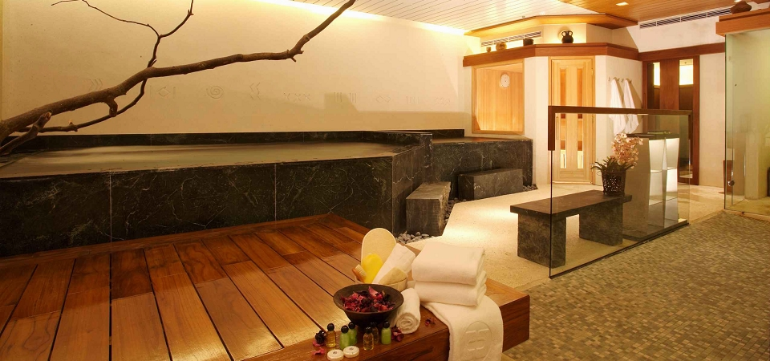
amenity
(n.) that which is pleasant or agreeable; (pl.) attractive features, customs, etc.
When I backpack, there are certain basic amenities, such as hot meals and a dry tent, that I will not go without.
Antonyms: unpleasantness, disagreeableness

Slide 3
aperture
(n.) an opening, gap, hole; orifice
After the earthquake, rain and cold came through the aperture in the wall of the damaged house.
Antonyms: closure, blockage, occlusion

Slide 4
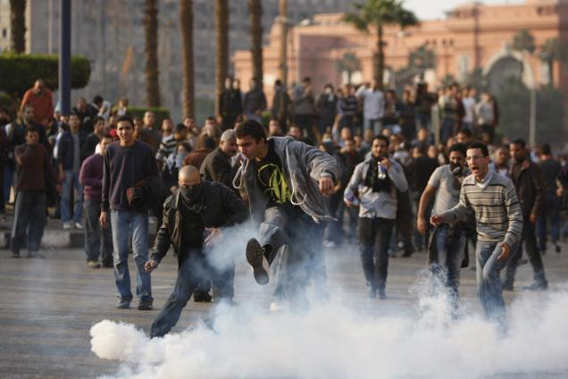
dissidence
(n.) a difference of opinion; discontent
When the commanding officer announced that all leave was cancelled, there was widespread dissidence in the ranks.
Synonyms: disagreement, disaffection
Antonyms: harmony, concord

Slide 5
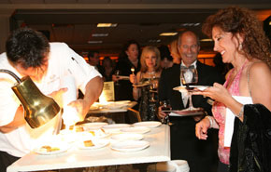
epicurean
(adj.) devoted to the pursuit of pleasure; fond of good food, comfort and ease; with discriminating tastes; (n.) a person with discriminating tastes
The chef took an epicurean delight in presenting the most delicious dishes to his demanding clientele.
Even the most fervent epicurean should not expect fine dining in a poor, war-torn country.
Synonyms: (adj.) sybaritic, discriminating
Antonyms: (adj.) ascetic, self-denying,
Abstemious

Slide 6
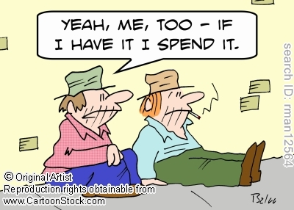
improvident
(adj.) not thrifty; failing to plan ahead
Some people are so improvident that despite high incomes they struggle to make ends meet.
Synonyms: prodigal, spendthrift,
extravagant
Antonyms: frugal, economical,
cautious

Slide 7
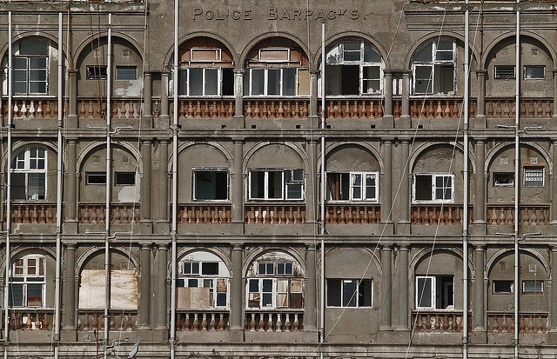
iniquity
(n.) wickedness, sin; a grossly immoral act
English Puritans looked upon the court that surrounded King Charles I as a den of iniquity.
Synonyms: evil, crime
Antonyms: probity, rectitude,
Uprightness

Slide 8
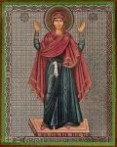
inviolable
(adj.) sacred; of such a character that it must not be broken, injured, or profaned
Safeguarding the retirement income of millions of Americans is an inviolable trust of the federal government.
Synonym: unassailable
Antonyms: vulnerable, assailable

Slide 9
mutable
(adj.) open to or capable of change, fickle
Most people would agree that one’s principles and moral values should not be as mutable as fashion.
Synonyms: changeable, variable
Antonyms: changeless, steadfast,
constant

Slide 10
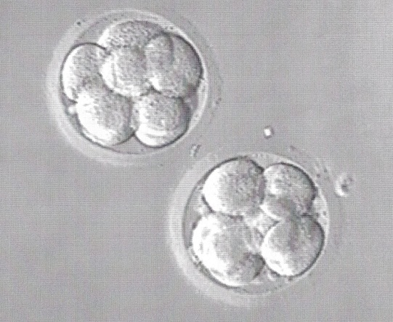
nascent
(adj.) just beginning to exist or develop; having just come into existence
Recent public opinion polls registered nascent opposition to the proposed tax increase.
Synonyms: incipient, embryonic
Antonyms: dying moribund, senescent

Slide 11
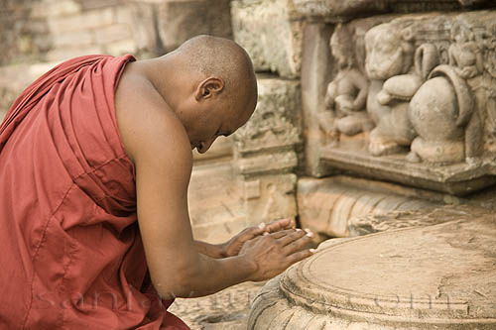
obeisance
(n.) a deep bow or other body movement indicating respect or submission; deference, homage
Upon entering the throne room, each courtier made a respectful obeisance before the king and queen.
Synonym: honor
Antonyms: disrespect, irreverence

Slide 12
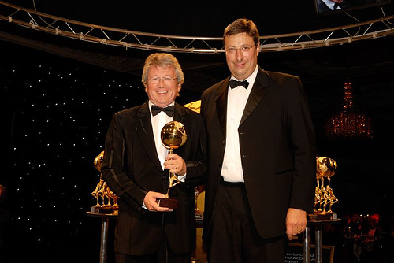
panegyric
(n.) formal or elaborate praise; a tribute
The speaker delivered a panegyric in honor of the award-winning author.
Synonyms: tribute, encomium,
testimonial
Antonyms: tirade, philippic

Slide 13
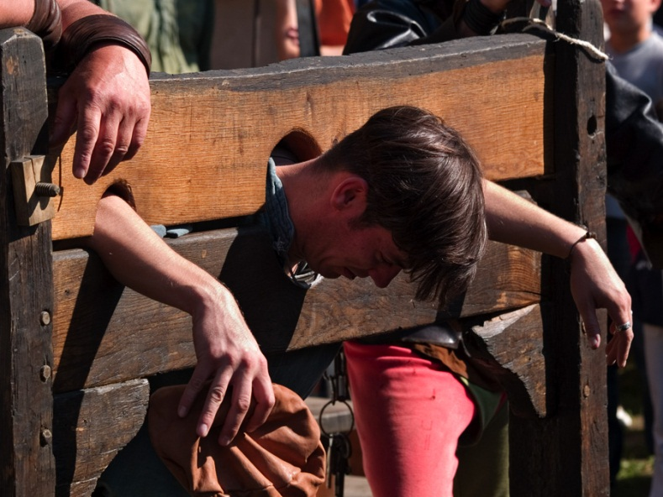
pillory
(n.) a device for publicly punishing offenders; a means for exposing one to public contempt or ridicule; (v.) to expose to public contempt or ridicule
The pillory was placed in the center of town so that everyone could view the outlaws and their shame.
The candidate tried to pillory her political opponent by suggesting that he had ties to organized crime.
Antonyms: (v.) extol, laud, acclaim

Slide 14
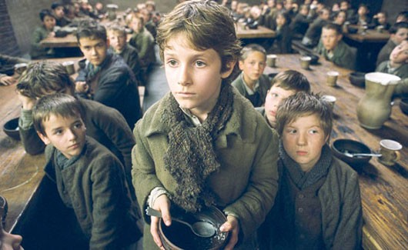
pittance
(n.) a woefully meager allowance, wage, or portion
In comparison to the overwhelming need for food and medicine, the shipment was a mere pittance.
Synonym: trifle
Antonym: fortune

Slide 15
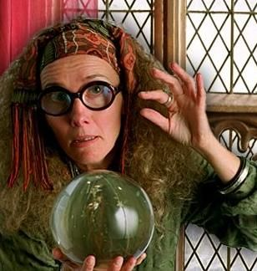
presage
(v.) to foreshadow or point to a future event; to predict; (n.) a warning or indication of the future
The skirmishes at the border presaged a war.
The fall in stock prices and retail sales may be a presage of hard economic times to come.
Synonyms: (v.) augur, foretell

Slide 16
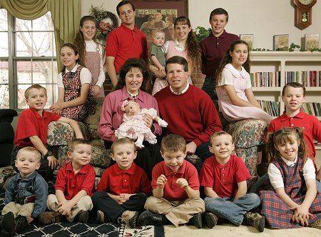
progeny
(n.) descendants, offspring, children, followers, disciples
The Bill of Rights guarantees certain civil rights and protections to us and our progeny.
Synonyms: issue, posterity
Antonyms: forebears,
antecendents

Slide 17
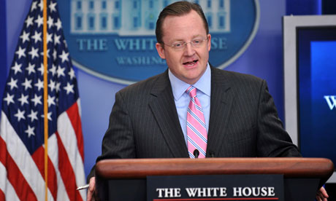
promulgate
(v.) to proclaim or issue officially; to make known far and wide
The School Board promulgated a new approach to education that emphasized phonics.
Synonym: announce
Antonyms: withdraw;
retract, abrogate, nullify

Slide 18
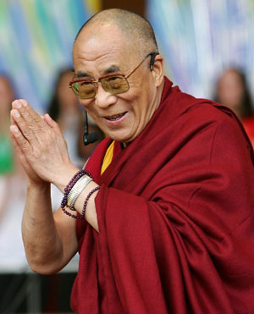
rectitude
(n.) uprightness, righteousness; correctness
The mayor is a person of unquestionable rectitude.
Synonyms: probity, integrity
Antonyms: iniquity, heinousness

Slide 19
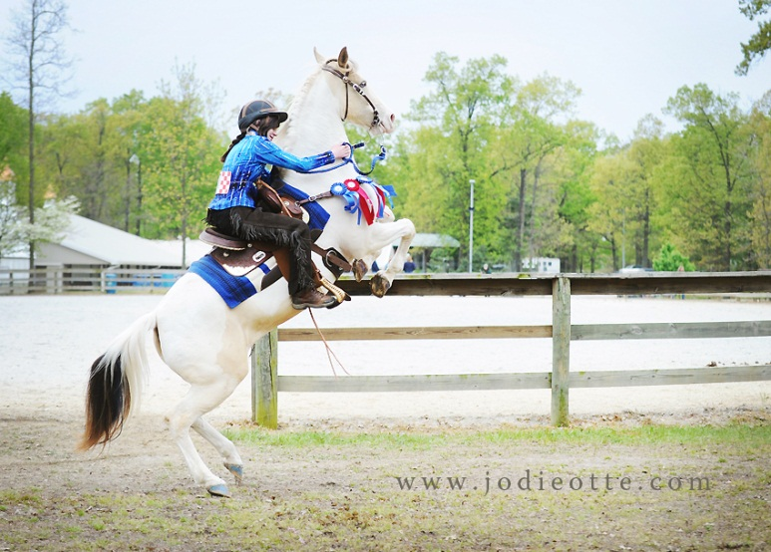
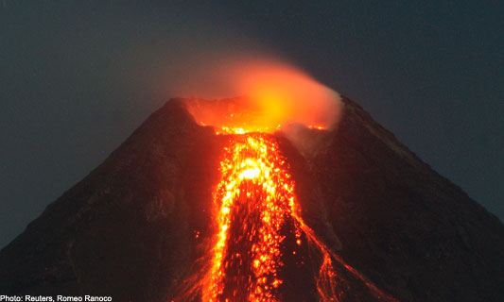
restive
(adj.) restless, hard to manage, balky
The restive horse had not been taken out of the stable for five days.
Synonyms: uneasy, recalcitrant
Antonyms: serene, unruffled, docile

Slide 20
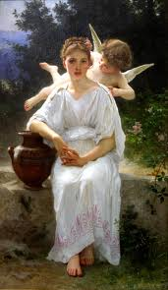
seraphic
(adj.) angelic, heavenly, celestial
The artist painted the children with seraphic smiles to suggest their innocence.
Synonym: cherubic
Antonym: devilish

Slide 21
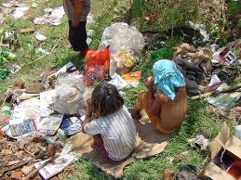
subsist
(v.) to have existence; to remain alive, manage to make a living or maintain life; to persist or continue
Peasants in nineteenth-century Ireland were able to subsist almost exclusively on potatoes.
Synonyms: last, sustain

