Slide 1
Vocabulary Unit 00
Prefixes Suffixes Roots

Slide 2
Prefixes

Slide 3
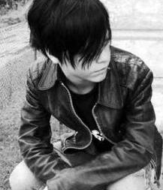
ANTI-
against
antisocial

Slide 4
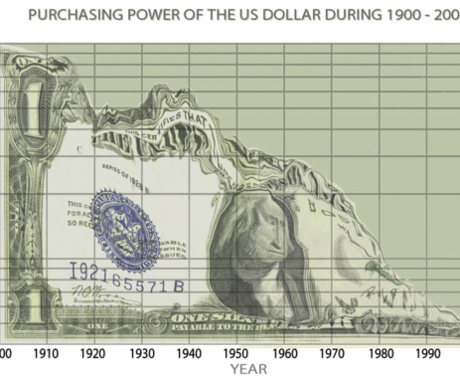
DE-
opposite
devalue

Slide 5
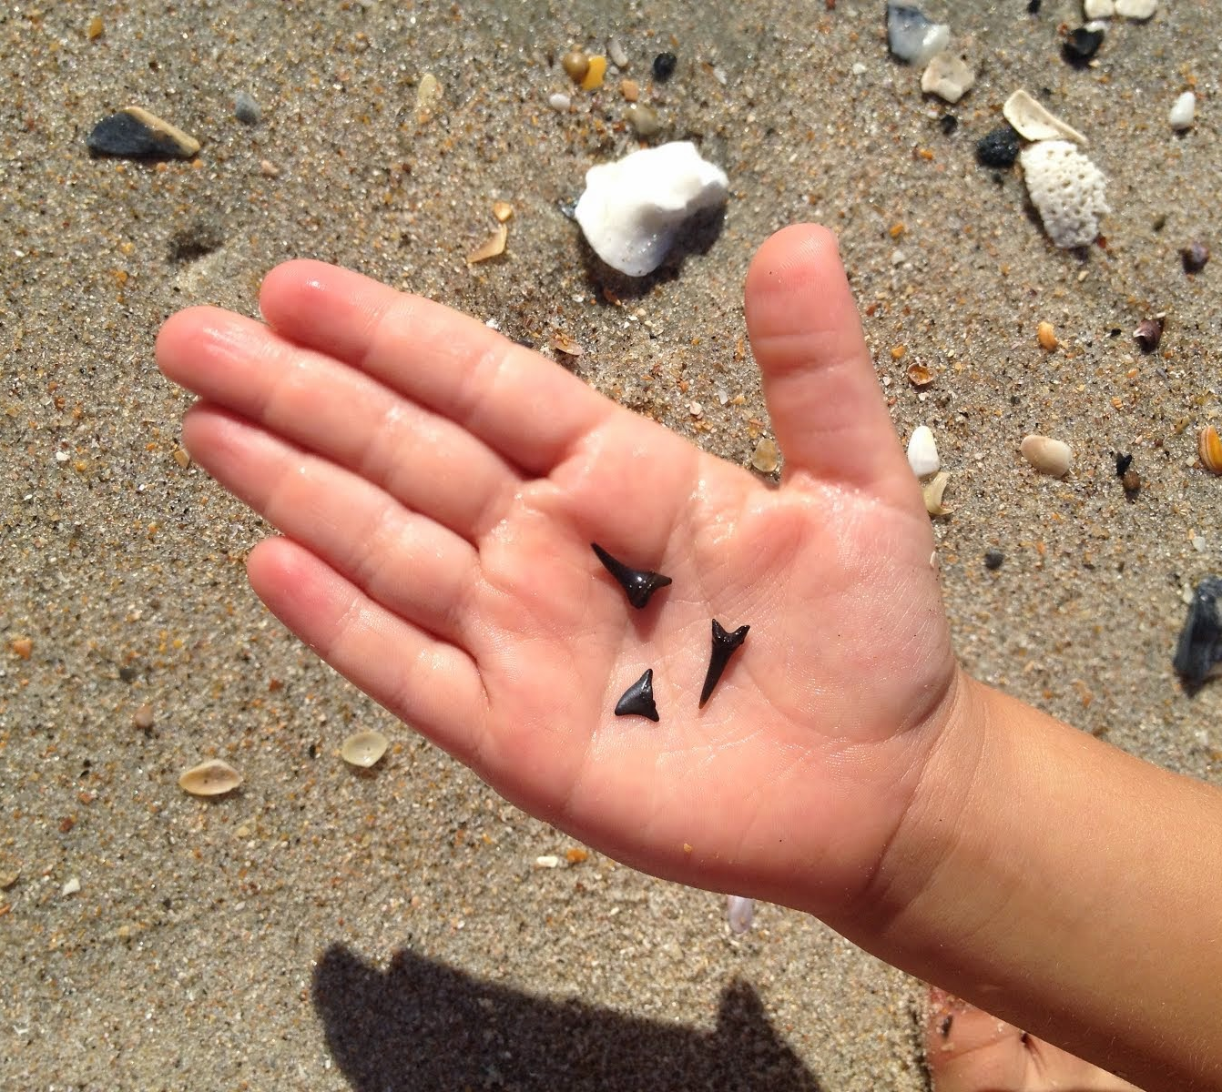
DIS-
not;
opposite of
discover

Slide 6

EN-
EM-
cause to
empower

Slide 7

FORE-
before;
front of
forearms

Slide 8
Suffixes

Slide 9
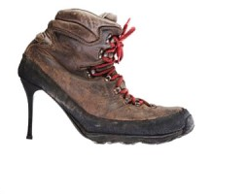
-ABLE
-IBLE
is; can be
(not) sensible

Slide 10
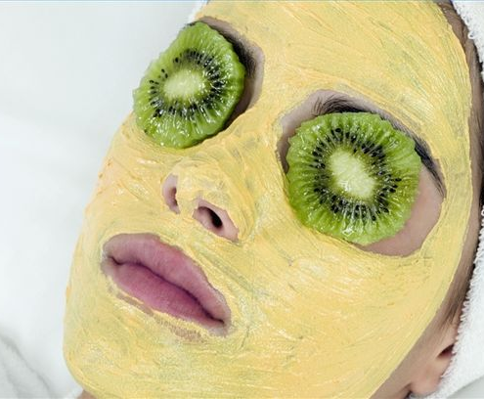
-IAL
-AL
having
characteristics of
facial

Slide 11

-ED
past tense verbs;
adjectives
walked

Slide 12
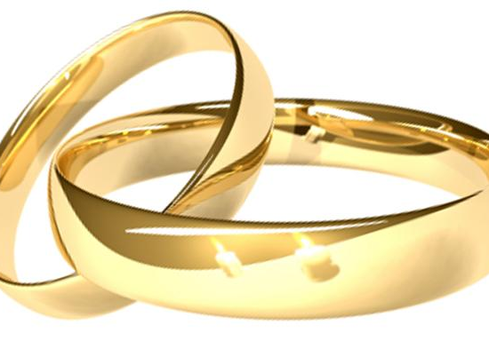
-EN
made of
golden

Slide 13
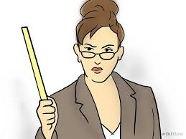
-ER
-OR
one who;
person connected with
teacher
professor

Slide 14
Roots

Slide 15
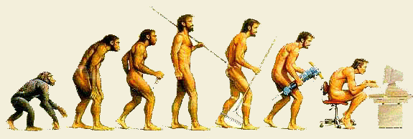
ANTHROPO
man;
human;
humanity
anthropology

Slide 16

AUTO
self
autobiography

Slide 17
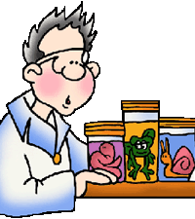
BIO
life
biology

Slide 18
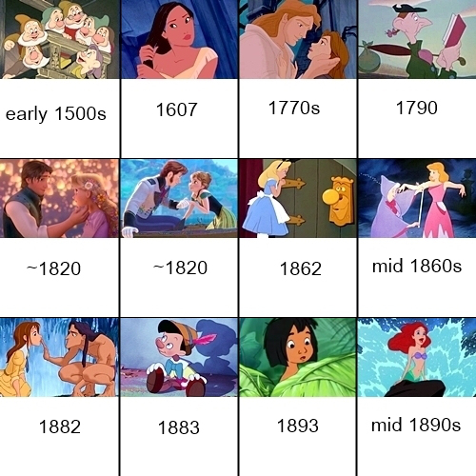
CHRON
time
chronological

Slide 19

DYNA
power
dynamite

Slide 20

AMBI
both
ambidextrous

Slide 21
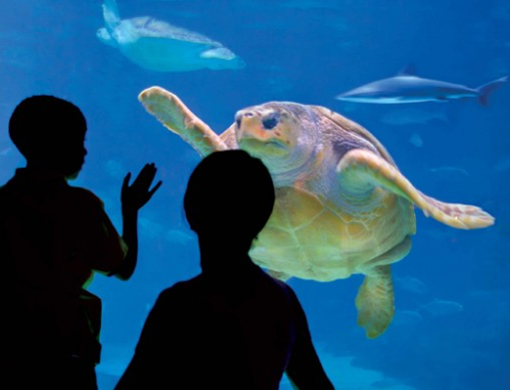
AQUA
water
aquarium

Slide 22
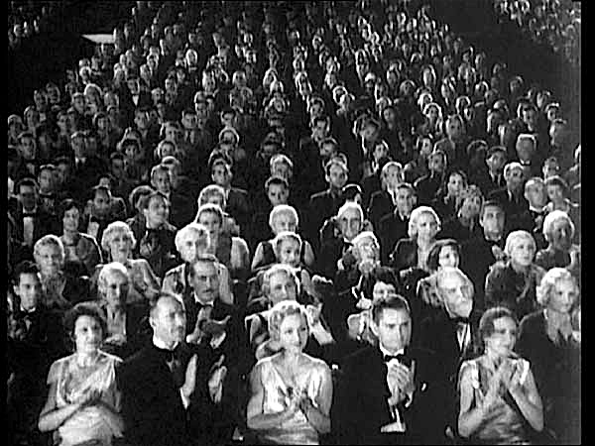
AUD
to hear
audience

Slide 23

BENE
good
beneful

Slide 24

CENT
one hundred
century

