Slide 1
Vocabulary Level D Unit 1
Includes Prefixes and Roots

Slide 2
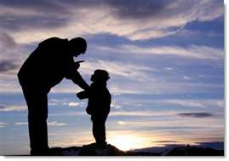
Admonish VERB to caution or advise against something; to scold mildly; to remind of a duty syn: to reprimand, to call on the carpet ant: praise, pat on the back

Slide 3
Commandeer VERB to seize for military or official use syn: take over, requisition, expropriate

Slide 4
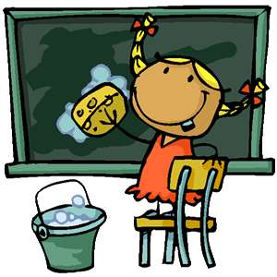
Efface VERB to wipe out; to keep oneself from being noticed syn: blot out, erase, obliterate, expunge

Slide 5
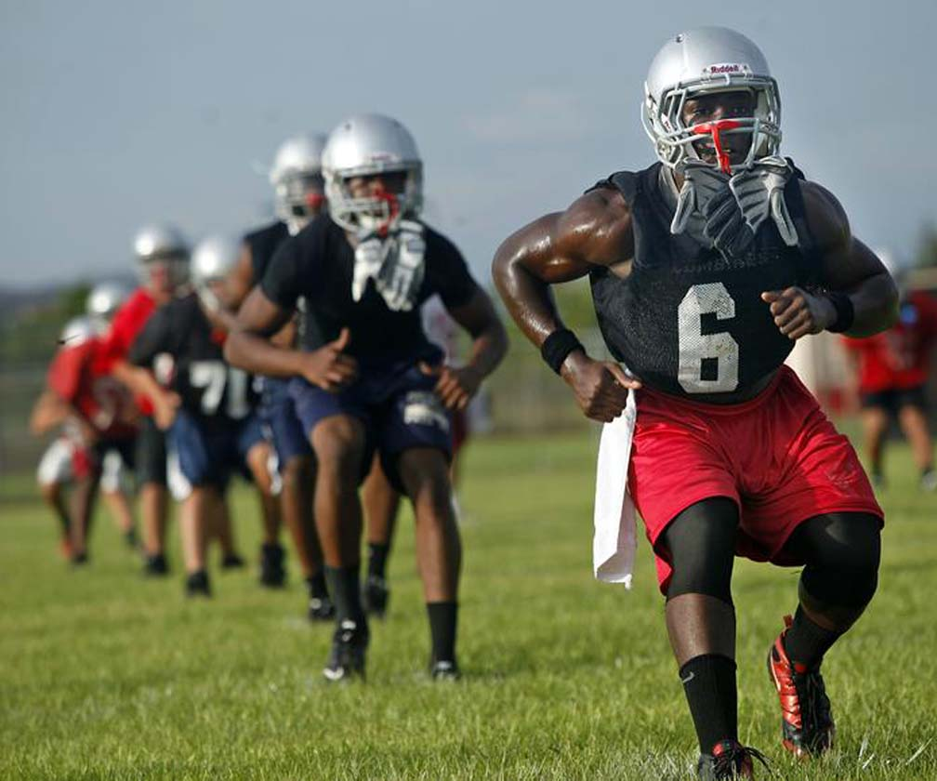
Predispose VERB to incline to beforehand syn: tending to, liable to ant: immunize against, shield from

Slide 6
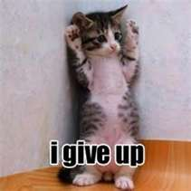
Relinquish VERB to let go, to up syn: to surrender ant: to hold on to, to keep, to cling to

Slide 7
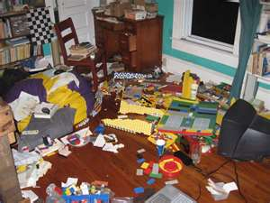
Muddle VERB to make a mess of; muddle through: to get by; syn: (v.) jumble, mess up Muddle NOUN a hopeless mess syn: (n.) confusion, disorder ant: (n.) orderliness, tidiness, neatness

Slide 8
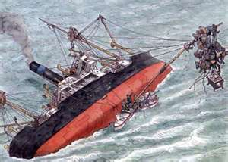
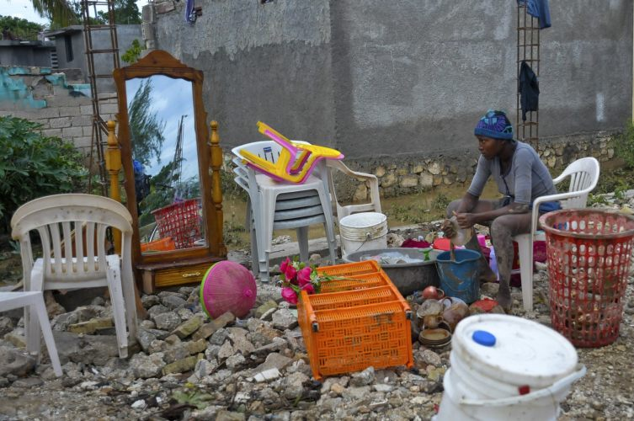
Salvage VERB to save from fire or shipwreck syn: (v.) to recover, to retrieve, to reclaim ant: (v.) to abandon, to scrap, to junk Salvage NOUN property saved from fire or shipwreck

Slide 9
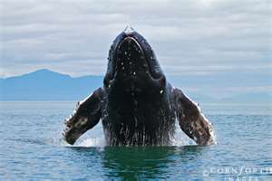
Breach VERB to create an opening, break through ant: (v.) to close, to seal Breach NOUN an opening, gap, rupture, rift; a violation or infraction

Slide 10
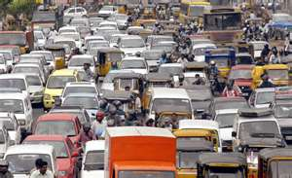
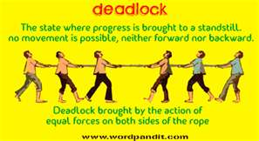
Deadlock VERB to bring to a standstill Deadlock NOUN standstill resulting from opposition of 2 equal forces/groups syn: (n.) standoff, stalemate, impasse ant: (n.) agreement, accord, breakthrough

Slide 11
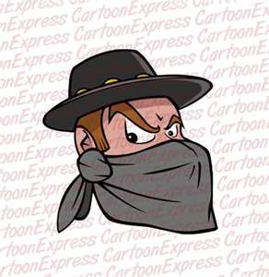
Brigand NOUN a bandit, robber, outlaw, highwayman

Slide 12
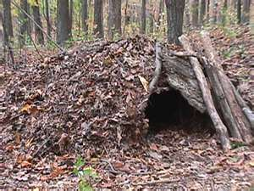
Debris NOUN scattered fragments, wreckage syn: rubble, detritus, flotsam and jetsam

Slide 13
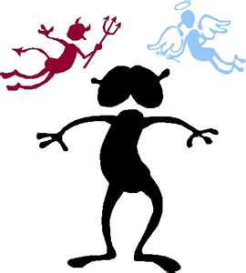
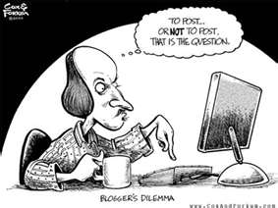
Dilemma NOUN a difficult or perplexing situation or problem syn: predicament, quandary, pickle, bind ant: cinch

Slide 14
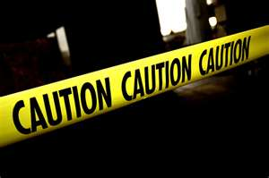
Circumspect ADJECTIVE careful, cautious syn: wary, prudent, guarded ant: incautious, rash, reckless, heedless

Slide 15
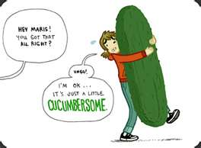
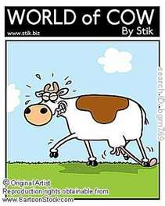
Cumbersome ADJECTIVE clumsy, hard to handle; slow-moving syn: unwieldy, ponderous ant: manageable, easy to handle

Slide 16
Perennial ADJECTIVE lasting for a long time, persistent syn: (adj.) enduring, recurring ant: (adj.) brief, short-lived, fleeting, ephemeral Perennial NOUN a plant that lives for many years

Slide 17
Spasmodic ADJECTIVE sudden and violent but brief; fitful; intermittent syn: irregular, occasional ant: steady, continuous, chronic

Slide 18
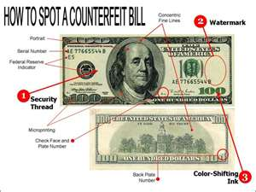
Spurious ADJECTIVE not genuine, not true, not valid syn: false, counterfeit, fraudulent, bogus ant: genuine, authentic, bona fide, valid

Slide 19
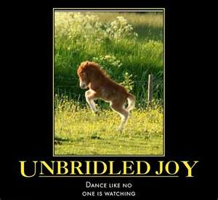
Unbridled ADJECTIVE uncontrolled, lacking in restraint syn: unrestrained, unchecked ant: restrained, held in check, muted

Slide 20
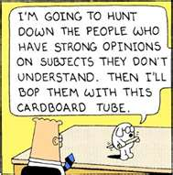
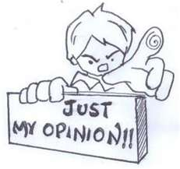
Opinionated ADJECTIVE stubborn and often unreasonable in holding to one’s own ideas, having a closed mind syn: obstinate, pigheaded, inflexible ant: open-minded, reasonable

Slide 21
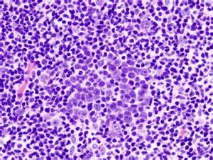
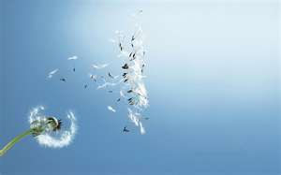
Diffuse ADJECTIVE wordy, long-winded, or unfocused; scattered/widely spread syn: (adj.) rambling, verbose, prolix ant: (adj.) brief, concise, succinct Diffuse VERB to spread or scatter freely or widely; syn: (v.) to disperse ant: (v.) to concentrate

Slide 22
Affixes and Roots

Slide 23
in- im- in
income

Slide 24
in- im- il- ir- not
illegible

Slide 25
inter- between, among
interrupt

Slide 26
mid- middle
midfield

Slide 27
mis- wrongly
misspell

Slide 28
circum around

