Slide 1
Unit 2 vocabulary
(with 5 prefixes & 1 root)
English 92
Level D

Slide 2
Adjourn
(v) To stop proceedings temporarily; move to another place
SYN: postpone, discontinue
ANT: open, call to order

Slide 3
Alien
(n) A citizen of another country; (adj) foreign, strange
SYN: (adj) exotic
ANT: (adj) native, endemic

Slide 4
COMELY
(adj) having a pleasing appearance
SYN: good-looking, attractive, bonny
ANT: plain, homely, ugly, repulsive

Slide 5
compensate
(v) To make up for; to repay for services
SYN: pay back, recompense
ANT: fail to reward, stiff

Slide 6
dissolute
(adj) loose in one’s morals or behavior
SYN: dissipated, debauched, immoral, corrupt
ANT: chaste, moral, seemly, proper

Slide 7
erratic
(adj) not regular or consistent; different from what is ordinarily expected; undependable
SYN: irregular, inconsistent
ANT: steady, consistent, dependable

Slide 8
expulsion
(n) The process of driving or forcing out
SYN: ejection, removal, eviction
ANT: admittance, admission

Slide 9
feint
(n) A deliberately deceptive movement; a pretense
(v) To make a deceptive movement; to make a pretense of
SYN: (n) trick, ruse, subterfuge, bluff

Slide 10
fodder
(n) Food for horses and cattle; raw material for a designated purpose
SYN: provender

Slide 11
fortify
(v) To strengthen, buildup
SYN: reinforce, shore up
ANT: weaken, undermine, sap, impair

Slide 12
Illegible
(adj) difficult or impossible to read
SYN: unreadable, scribbled
ANT: readable, distinct, clear

Slide 13
jeer
(v) To make fun of rudely or unkindly
(n) A rude remark of derision
SYN: (v) laugh at, mock, taunt; (n) gibe, insult
ANT: (v) applaud, praise; (n) applause, plaudits

Slide 14
LUCRATIVE
(adj) bringing in money; profitable
SYN: gainful, moneymaking
ANT: unprofitable, losing, in the red

Slide 15
mediocre
(adj) average, ordinary, undistinguished
SYN: run-of-the-mill
ANT: outstanding, distinguished

Slide 16
proliferate
(v) To reproduce, increase, or spread rapidly
SYN: multiply, mushroom, burgeon
ANT: decrease, diminish, dwindle, slack off

Slide 17
subjugate
(v) To conquer by force, bring under complete control
SYN: subdue, vanquish
ANT: be conquered, submit

Slide 18
sully
(v) To soil, stain, tarnish, defile, besmirch
SYN: pollute, taint, smear
ANT: cleanse, purify, decontaminate

Slide 19
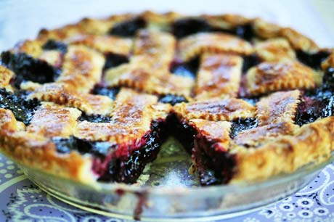
tantalize
(v) To tease, torment by teasing
SYN: tempt, lead on, make one’s mouth water
ANT: satisfy, fulfill, gratify

Slide 20
terse
(adj) brief and to the point
SYN: succinct, crisp, short and sweet
ANT: wordy, diffuse, prolix

Slide 21
unflinching
(adj) firm, showing no sign of fear, not drawing back
SYN: resolute, steadfast, unwavering
ANT: irresolute, wavering, vacillating

Slide 22
Prefixes & root word

Slide 23
Non-
Not
Nondairy
Nonviolent

Slide 24
Over-
Over; too much
Overeat
Overprepared

Slide 25
Pre-
Before
Preview

Slide 26
Re-
Again
Redundant
Rewrite
Retake
Redo

Slide 27
Semi-
Half; partly; not fully
Semifinal
Semiprofessional

Slide 28
Contra/ counter
Against
Contradict
Encounter

