Slide 1
Vocabulary unit 3 plus 5 prefixes & 1 root

Slide 2
Super-
Above, Beyond
Superman
Super Man
Regular Man

Slide 3
Sub-
Under
Submarine

Slide 4
Trans-
Across
Transatlantic

Slide 5
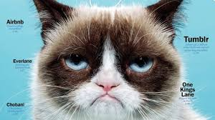
Un-
Not; Opposite of
unusual

Slide 6
Under-
Too little
underestimate

Slide 7
dict
To say
dictation

Slide 8
abridge
Verb - To make shorter
Syn – shorten, condense, abbreviate
Ant – expand, enlarge, augment

Slide 9
adherent
Noun – a follower, supporter
Adjective – attached, sticking to
Syn – (n) disciple
Ant – (n) opponent, adversary, critic, detractor

Slide 10
altercation
Noun – an angry argument
Syn – quarrel, dispute, squabble
Ant – agreement, accord

Slide 11
cherubic
Adjective – resembling an angel; sweet & innocent
Syn – beatific
Ant – impish, devilish, diabolic, fiendish

Slide 12
condone
Verb – to pardon or overlook
Syn – ignore, wink at, look the other way
Ant – censure, condemn, disapprove, deprecate

Slide 13
dissent
Verb – to disagree
Noun – a disagreement
Syn – (v) to differ, to dispute
Ant – (v) to agree, to concur; (n) unanimity

Slide 14
eminent
Adj – famous, outstanding, distinguished; projecting
Syn – illustrious, renowned
Ant – nameless, unsung, lowly, humble

Slide 15
exorcise
Verb – to drive out by magic; to dispose of something troublesome
Syn - expel

Slide 16
fabricate
Verb – to make, manufacture; to make up, to invent
Syn – put together, devise, concoct
Ant – take apart, undo, destroy

Slide 17
gluttony
Noun – engaging in extreme eating or drinking; greedy overindulgence
Syn – overeating, ravenousness
Ant – abstemiousness

Slide 18
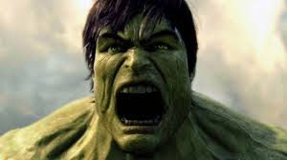
irate
Adjective - angry
Syn – incensed, infuriated, livid
Ant – calm, composed, cool, unruffled

Slide 19
Marauder
Noun – a raider, plunderer
Syn – looter, pirate

Slide 20
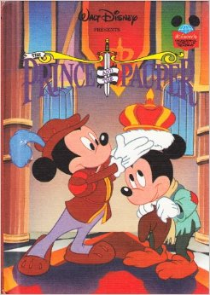
Pauper
Noun – an extremely poor person
Syn – destitute person
Ant - billionaire

Slide 21
Pilfer
Verb – to steal in small quantities
Syn – rob, swipe, purloin

Slide 22
rift
Noun – a split, break, breach
Syn – crack, fissure, gap, cleft
Ant - reconciliation

Slide 23
semblance
Noun – a likeness; an outward appearance; an apparition
Syn – air, aura, facade
Ant – dissimilarity, contrast, total lack

Slide 24
surmount
Verb – to overcome, to rise above
Syn – conquer, triumph over
Ant – be vanquished, be defeated, succumb to

Slide 25
terminate
Verb – to bring to an end
Syn – conclude, finish, discontinue
Ant – begin, commence

Slide 26
trite
Adjective – commonplace; overused, stale
Syn – banal, hackneyed, corny
Ant – original, innovative

Slide 27
usurp
Verb – to seize and hold a position by force or without right
Syn – seize illegally, supplant

