Slide 1
Vocabulary Unit 4 Level D
Plus 5 Prefixes and 1 Root

Slide 2
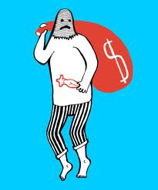
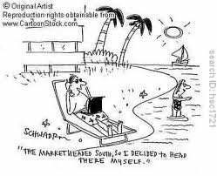
Abscond VERB
to run off and hide

Slide 3
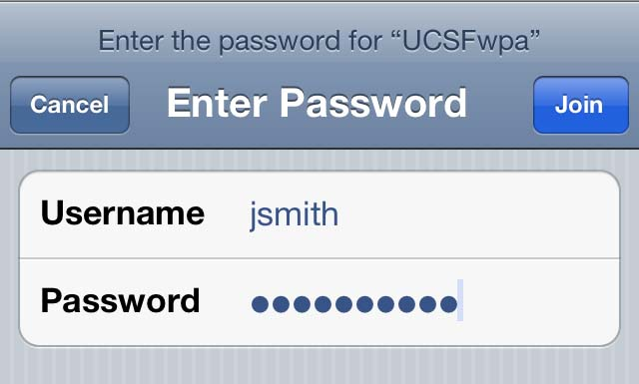
Access NOUN & VERB
(n.) approach or admittance to places, person, things
(v.) to get at, obtain

Slide 4
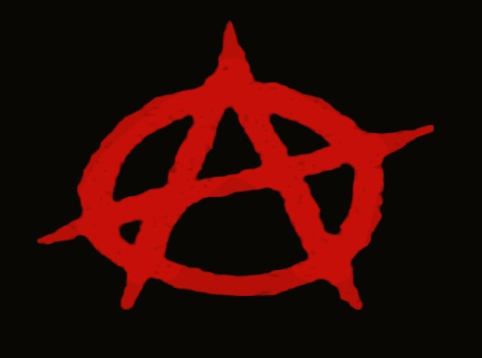
Anarchy NOUN
a lack of government and law; confusion

Slide 5
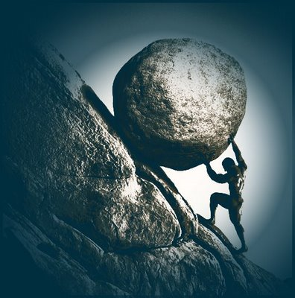
Arduous ADJECTIVE
hard to do, requiring much effort

Slide 6
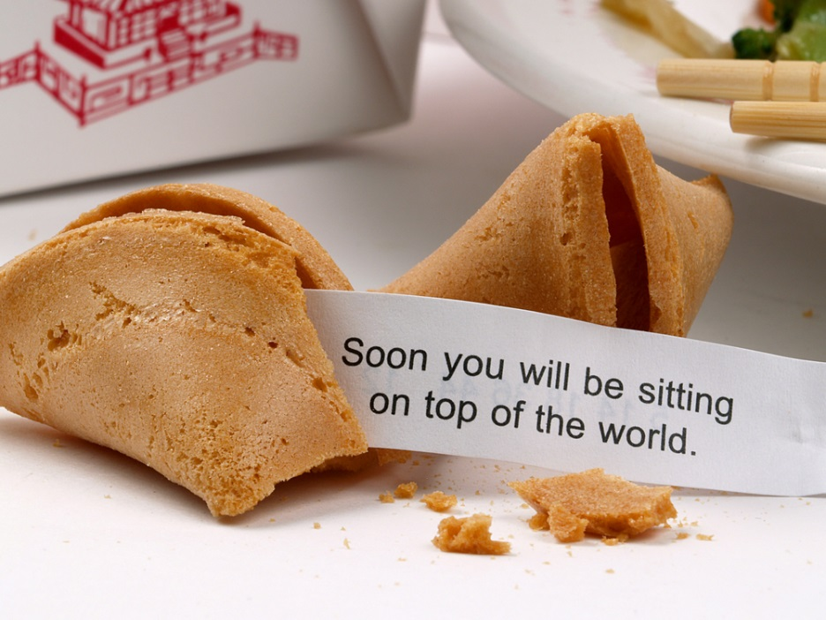
Auspicious ADJECTIVE
favorable; fortunate

Slide 7
Daunt VERB
to overcome with fear, intimidate

Slide 8
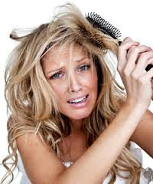
Disentangle VERB
to free from tangles or complications

Slide 9
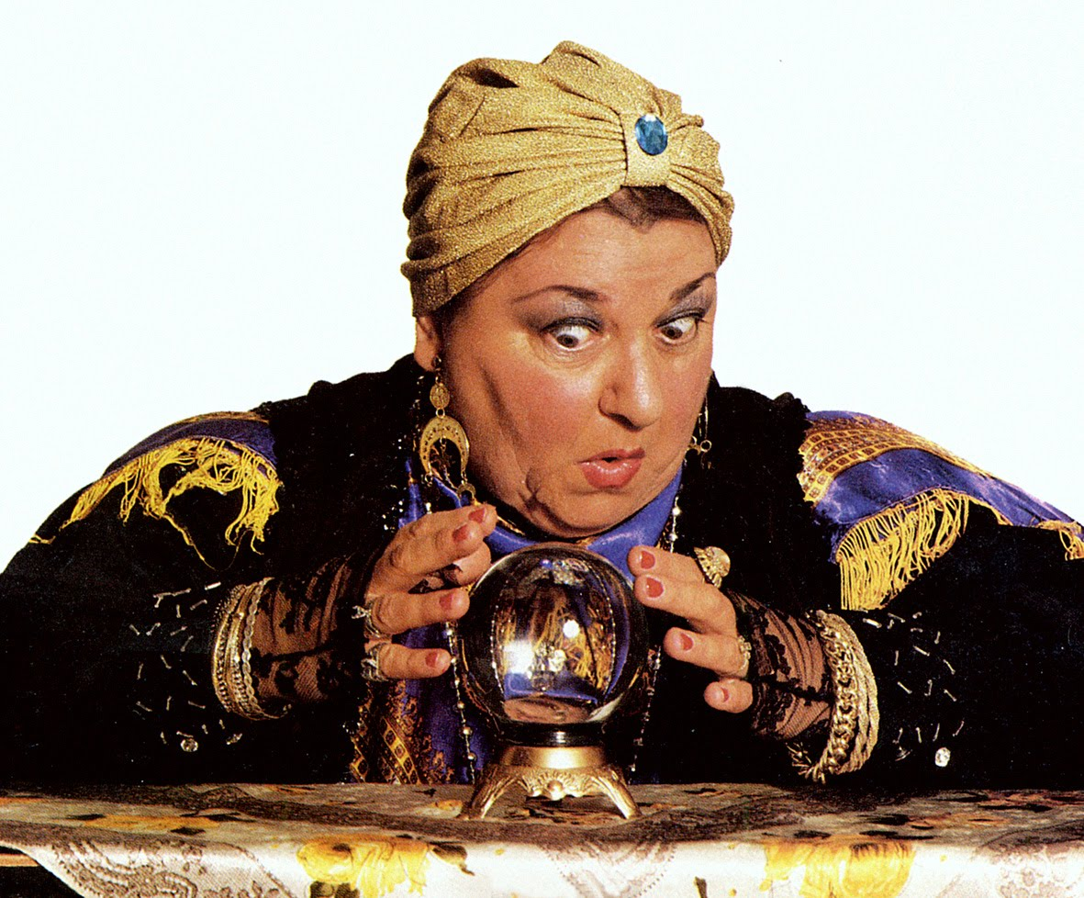
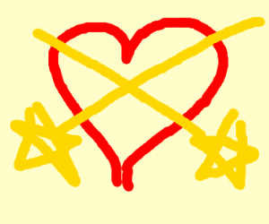
Fated ADJECTIVE
determined in advance by destiny or fortune

Slide 10
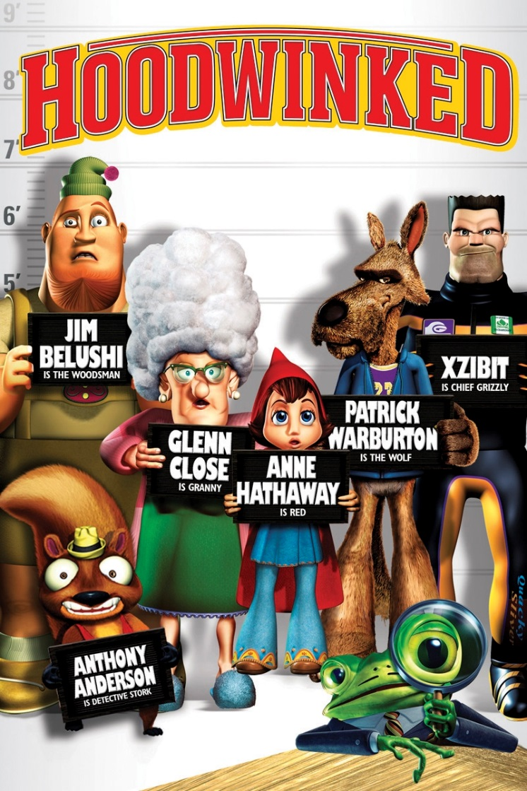
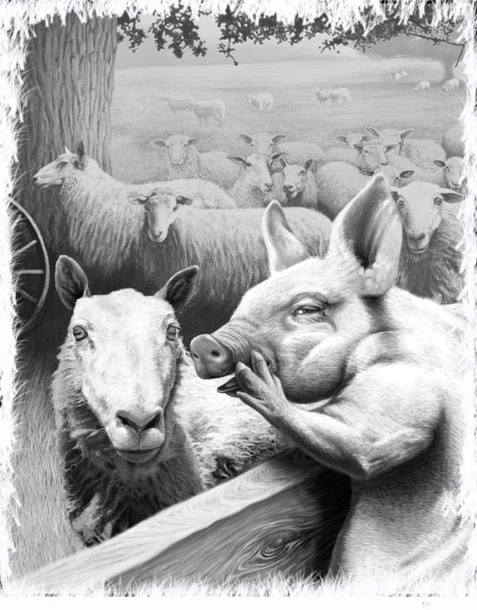
Hoodwink VERB
to mislead by a trick, swindle

Slide 11
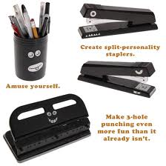
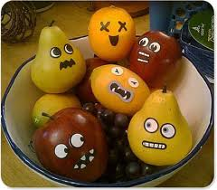
Inanimate ADJECTIVE
not having life; without energy or spirit

Slide 12
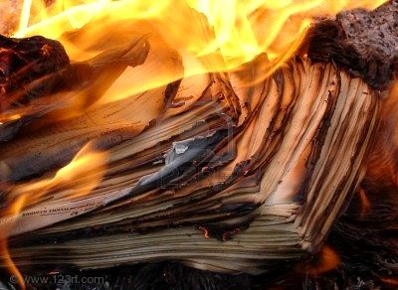
Incinerate VERB
to burn to ashes

Slide 13
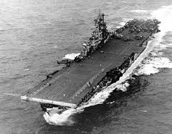
Intrepid ADJECTIVE
very brave, fearless, unshakable

Slide 14
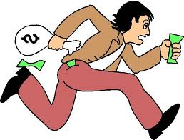
Larceny NOUN
theft

Slide 15
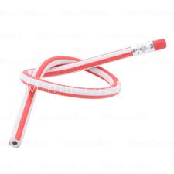
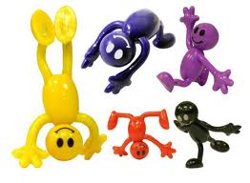
Pliant ADJECTIVE
bending readily; easily influenced

Slide 16
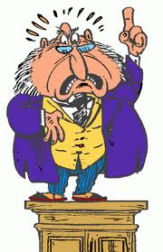
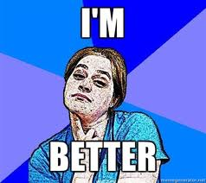
Pompous ADJECTIVE
overly self-important in speech and manner; excessively stately

Slide 17
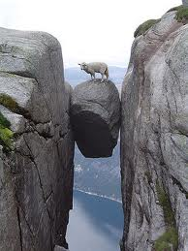
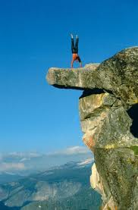
Precipice NOUN
a very steep cliff; the brink of edge of disaster

Slide 18
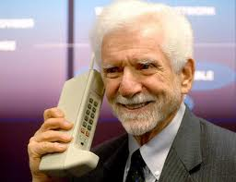
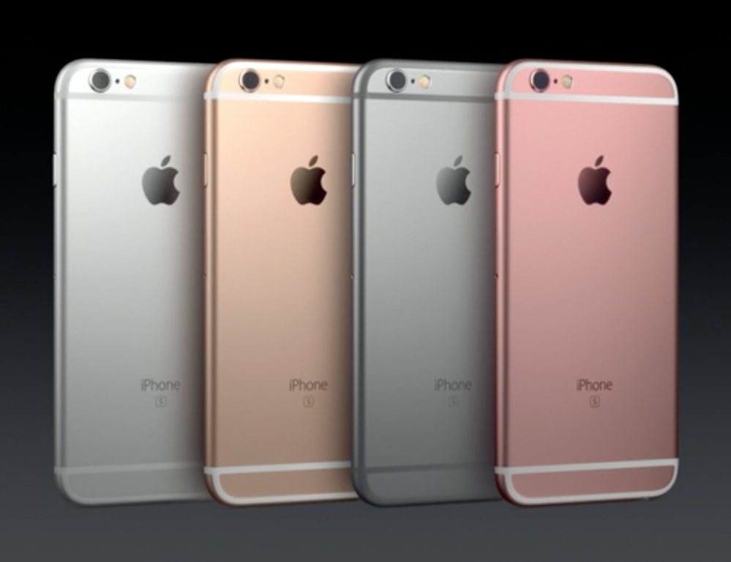
Prototype NOUN
an original model on which later versions are patterned

Slide 19
Rectify VERB
to make right, correct

Slide 20
Reprieve NOUN & VERB
(n.) a temporary relief or delay
(v.) to grant a postponement

Slide 21
Revile VERB
to attack with words, call bad names

Slide 22
5 Suffixes & 1 Root

Slide 23
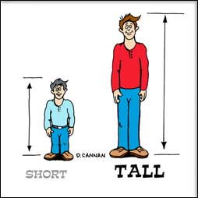
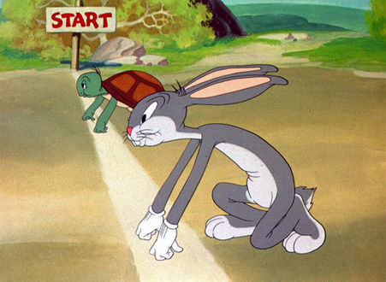
-er more
Taller, faster, stronger

Slide 24
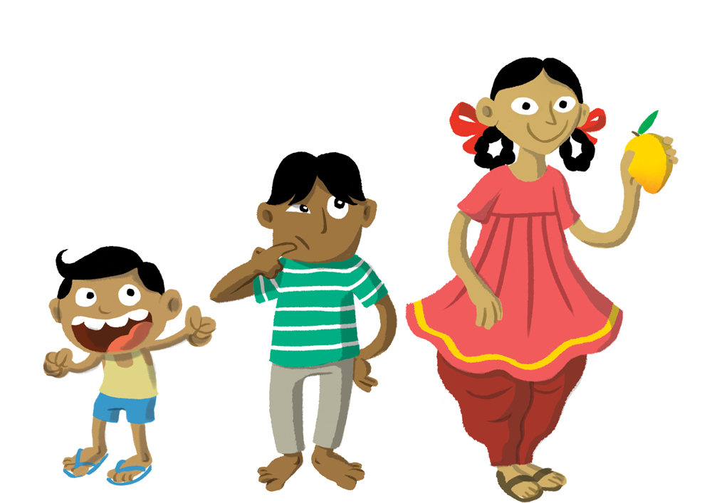
-est most
Tallest, fastest, strongest

Slide 25
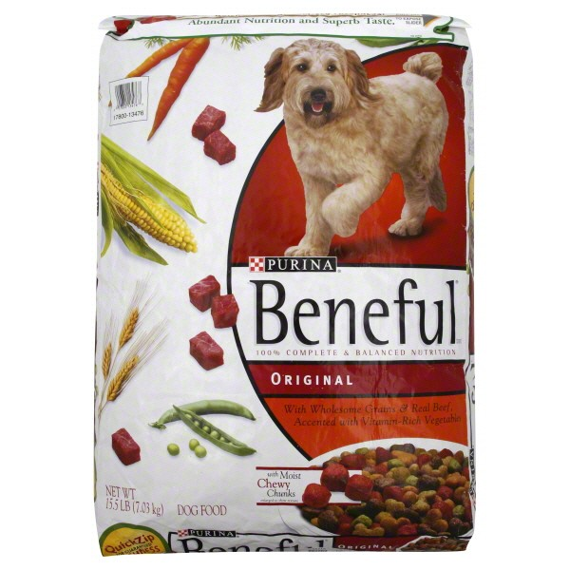
-ful full of
Helpful, beautiful

Slide 26
-ic having characteristics of
academic

Slide 27
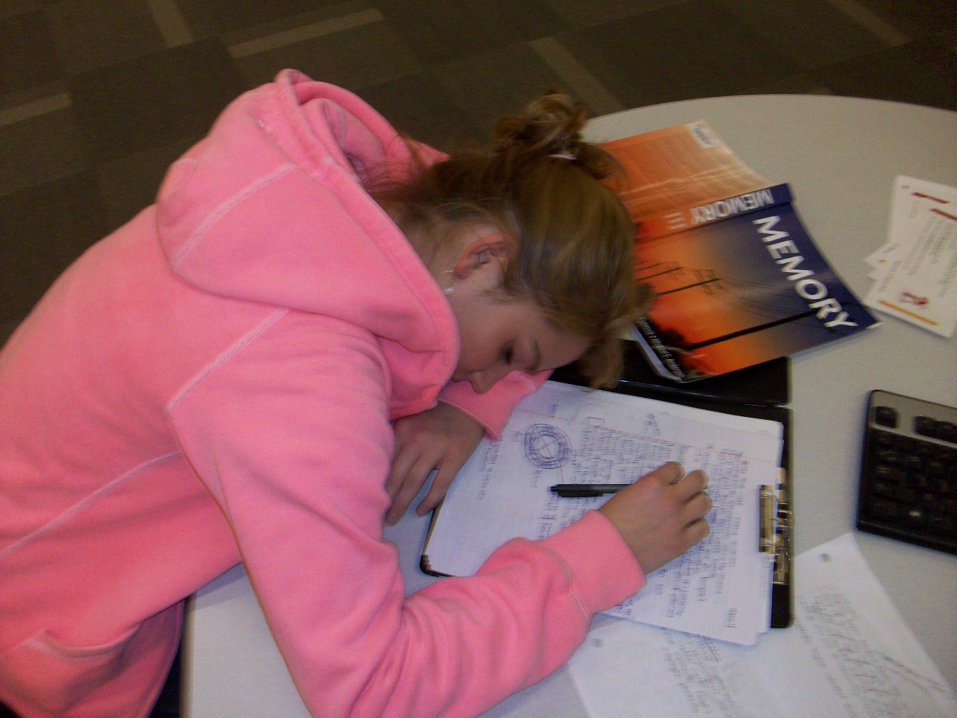
-ing verb form; present participles
sleeping

