Slide 1
VOCABULARY UNIT 6
Many of the words in this unit are very similar.
Their definitions have only slight differences.
Use this PowerPoint to help you learn their variances.

Slide 2
hamper - bondage – hew – tenacious
All four words have to do with holding
To hold back – hamper (verb)
Being held down – bondage (noun)
To hold to – hew (verb)
Holding fast, holding together firmly – tenacious (adjective)
A car wreck may hamper your drive to school. The car wreck will hold you back and slow you down.
A slave is held in bondage; they are held against their will.
Even on Halloween, students must hew to the dress code. The dress code will still be held up and enforced.
A sailor must hold fast to ropes on the ship during a storm; they must be tenacious in their job of securing the ropes.

Slide 3
HAMPER verb – to hold back

Slide 4
BONDAGE noun – being held down

Slide 5
HEW verb – to hold to

Slide 6
TENACIOUS adjective - holding fast, holding together firmly

Slide 7
diligent – incessant – tenacious
All are adjectives
All describe someone who is hardworking
A diligent person is very reliable and not lazy.
An incessant noise goes on and on and on and on and never stops - almost to the point of annoyance.
A tenacious person is stubborn; they don’t give up on their goal no matter what.

Slide 8
DILIGENT adjective – reliable and not lazy

Slide 9
INCESSANT adjective – goes on and on to the point of annoyance

Slide 10
TENACIOUS adjective – stubborn; don’t give up on goals

Slide 11
doleful – ghastly – sardonic
All are adjectives
All describe someone or something that is negative or sad
A doleful person is very sad and always depressed; they are pessimists.
A ghastly movie is scary and horrible. People are not usually described as ghastly.
A sardonic comment is an extremely negative sarcastic comment; it is mocking and sharp.

Slide 12
DOLEFUL adjective – sad, depressed, pessimistic

Slide 13
GHASTLY adjective – scary and horrible

Slide 14
SARDONIC adjective – extremely negative and sarcastic

Slide 15
posthumous – ghastly
Both are adjectives
Both relate to death
If something happens after a person dies, it happens posthumously; a person’s funeral happens posthumously.
If someone looks ghastly, they are deathly pale; their skin is very white, like a ghost.

Slide 16
POSTHUMOUS adjective – after death

Slide 17
GHASTLY adjective – deathly pale

Slide 18
credible – lucid
Both are adjectives
Both describe something you can believe, easily understand, and trust.
When you look at information online, you want to be sure you are looking at credible sources; only believe information from sources that tell the truth and are trustworthy.
If someone is lucid, they are able to explain themselves clearly; you can hear them and understand what they are saying.
Opposite to these two words is intricate.
If something is complicated and hard to understand, it is intricate.
Lacework and embroidery (on fabrics) is often referred to as intricate because it is so detailed with tiny stitches.

Slide 19
CREDIBLE adjective – true and trustworthy

Slide 20
LUCID adjective – clear and understandable

Slide 21
INTRICATE adjective – very detailed

Slide 22
taunt – sardonic
to jeer at, to mock – taunt (verb)
bitterly sarcastic – sardonic (adjective)
Both refer to negatively speaking about or to someone.
Taunt is an action and sardonic is a description of someone who taunts.
Taunt is similar to a previous vocab word: jeer.

Slide 23
TAUNT verb - to jeer at, to mock

Slide 24
SARDONIC adjective – bitterly sarcastic

Slide 25
bondage – impoverished
slavery; being held down – bondage (noun)
poor, poverty - impoverished (adjective)
Both are undesirable. You would not want to be held in bondage and you would not want to be impoverished.
A person who is in bondage may be impoverished.
Slaves were impoverished because they depended upon their owners to provide for them; they were not paid for their work.
Almost opposite to impoverished is superfluous.
If a person is impoverished they are poor and in poverty; they do not have very many belongings.
Most people who have superfluous things and belongings, have more than enough or more than they need.

Slide 26
BONDAGE noun – being held down; slavery

Slide 27
IMPOVERISHED adjective – poor, poverty

Slide 28
SUPERFLUOUS adjective – more than enough

Slide 29
defray – atone
Both are verbs (actions)
Defray will refer to money, bills, or expenses.
If you get a scholarship to college, the scholarship money helps to defray the cost of college.
Atone will refer to a person’s actions or inactions and their need to ask for forgiveness.
If you confess your actions to a priest, he will tell you what you need to do to atone for your sins.

Slide 30
DEFRAY verb – to provide money to pay

Slide 31
ATONE verb – to make amends or repairs

Slide 32
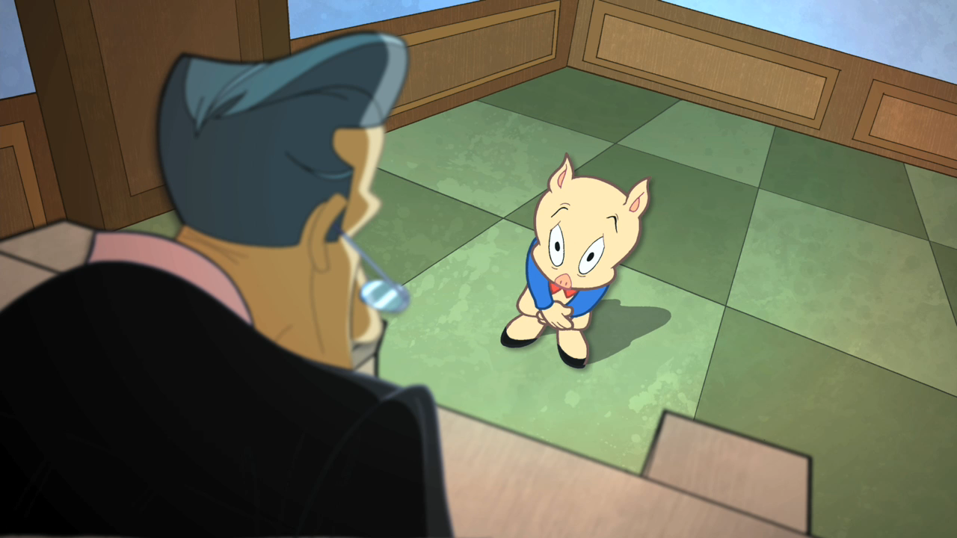
-ment state of being; act of
judgement

Slide 33
-ness state of; condition of
tightness

Slide 34
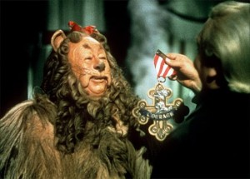
-ous, -eous, -ious having qualities of
courageous

Slide 35
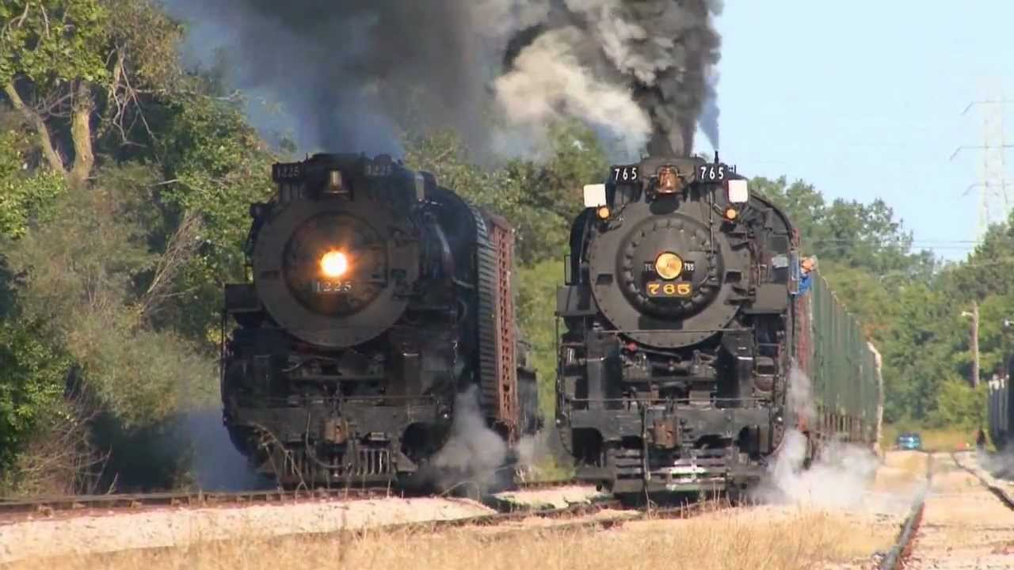
-s, -es more than one
trains

Slide 36
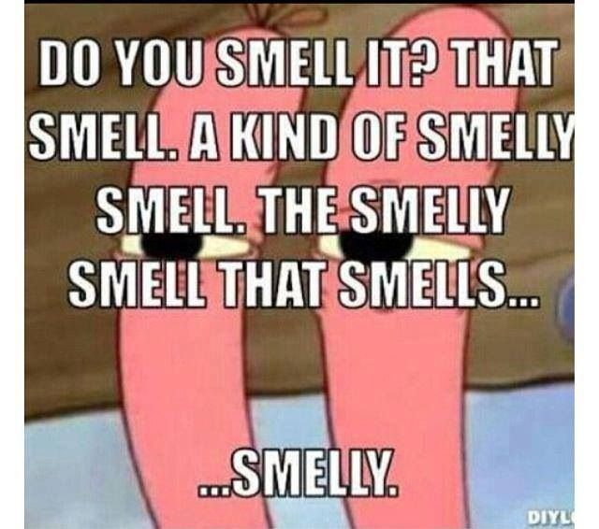
-y characterized by
Smelly

