Slide 1
Vocabulary Unit 7
9th Grade Level D

Slide 2
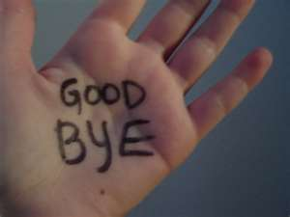
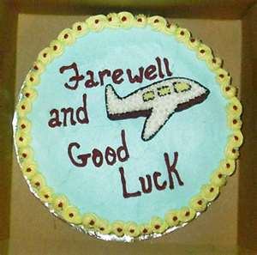
Adieu NOUN
An interjection meaning “Farewell!”
a farewell or good-bye

Slide 3
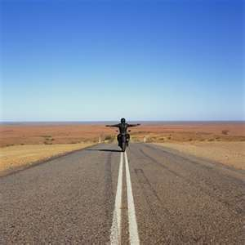
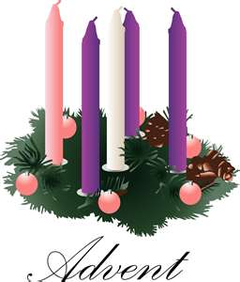
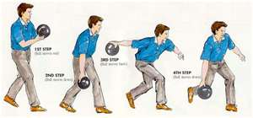
Advent NOUN
(n.) an arrival; a coming into place or view
Syn – approach
Ant – departure, going away, exodus

Slide 4
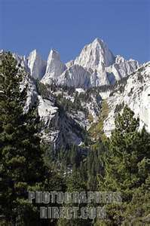
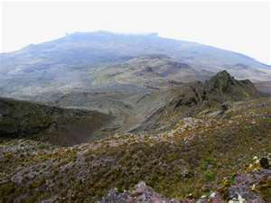
Apex NOUN
(n.) the highest point; the tip
Syn – the peak, summit, acme, crowning point
Ant – bottom, nadir

Slide 5
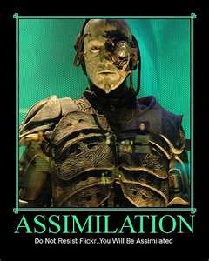
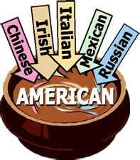
Assimilate VERB
(v.) to absorb fully or make one’s own; to adopt as one’s own; to adapt fully
Syn. – digest, incorporate, blend in

Slide 6
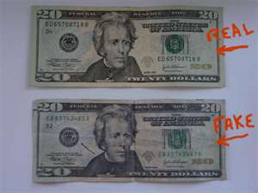
Bogus ADJECTIVE
(adj.) false, counterfeit
Syn. – phony, fake, spurious
Ant. – genuine, authentic

Slide 7
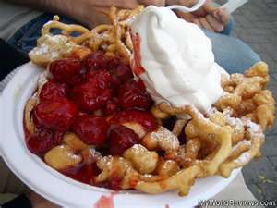
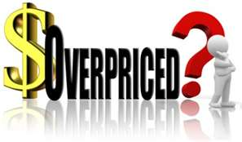
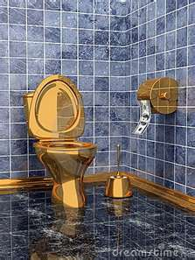
Exorbitant ADJECTIVE
(adj.) unreasonable high; excessive
Syn. – extreme, inordinate, overpriced
Ant. – inexpensive, affordable, reasonable

Slide 8
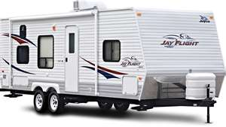
Interim NOUN & ADJECTIVE
(n.) the time between (adj.) temporary
Syn. – (n.) interval (adj.) provisional
The trailer was our interim home while we worked on the construction of our new house.

Slide 9
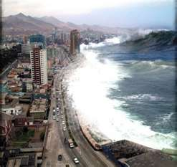
Inundate VERB
(v.) to flood, overflow; to overwhelm by numbers or size
Syn.- submerge, deluge, swamp

Slide 10
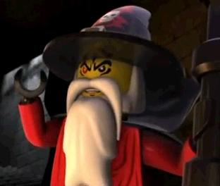
Malign VERB & ADJECTIVE
(v.) to speak evil of, slander; (adj.) evil
Syn. – defame, vilify, badmouth
Ant. – praise, commend
Mallock the Malign speaks evil of people

Slide 11
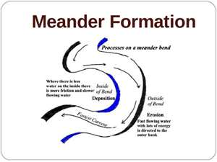
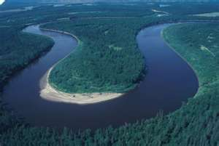
Meander VERB & NOUN
(v.) to wander about, wind about; (n.) a sharp turn or twist
Syn. – ramble, roam, zigzag, twist

Slide 12
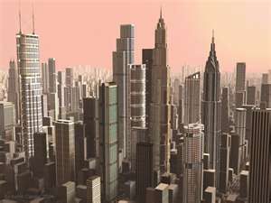
Metropolis NOUN
(n.) a large city; the chief city of an area
Syn. – a large urban center
Ant. – hamlet, village

Slide 13
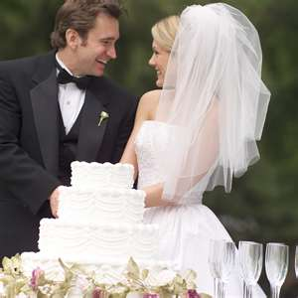
Momentous ADJECTIVE
(adj.) very important
Syn. – consequential, weighty, portentous
Ant. – inconsequential, trivial, slight
Weddings and presidential elections are both momentous occasions

Slide 14
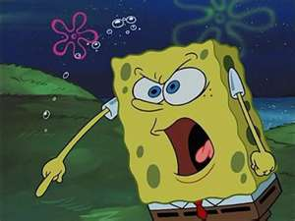
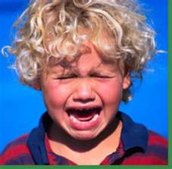
Obstreperous ADJECTIVE
(adj.) noisy, unruly, disorderly
Syn. – wild, rowdy, uncontrolled, riotous
Ant. – quiet, well-behaved, docile

Slide 15
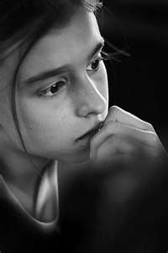
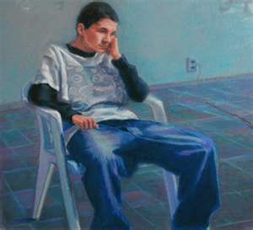
Pensive ADJECTIVE
(adj.) thoughtful; melancholy
Syn. – dreamy, reflective, contemplative

Slide 16
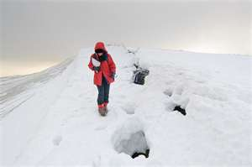
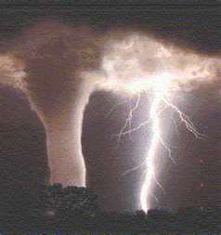
Perilous ADJECTIVE
(adj.) dangerous
Syn. – risky, chancy, hazardous
Ant. – safe, secure, harmless

Slide 17
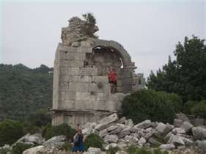
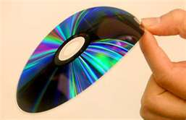
Shoddy ADJECTIVE
(adj.) of poor quality, characterized by inferior workmanship
Syn. – flimsy, cheap, tacky, imitative
Ant. – well-made, solid, durable, superior

Slide 18
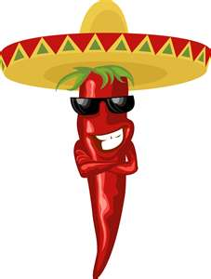
Sprightly ADJECTIVE
(adj.) lively, full of life; spicy, flavorful
Syn. – frisky, peppy, spirited, animated
Ant. – sullen, spiritless, dull, morose

Slide 19
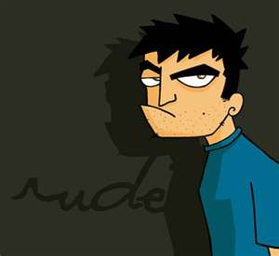
Surly ADJECTIVE
(adj.) angry and bad-tempered; rude
Syn. – gruff, sullen, cranky, grouchy, hostile
Ant. – polite, gracious, civil, friendly, genial

Slide 20
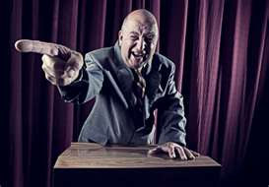
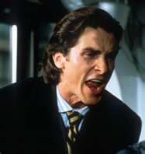
Tirade NOUN
(n.) a long, angry speech, usually very critical
Syn. – harangue, diatribe, tongue-lashing

Slide 21
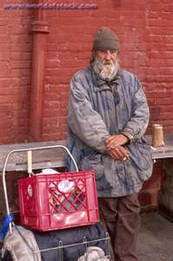
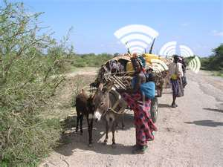
Vagrant NOUN & ADJECTIVE
(n.) an idle wanderer, tramp; (adj.) wandering aimlessly
Syn. – drifer, vagabond, hobo, nomad
Ant. – stay-at-home, homebody, resident

Slide 22
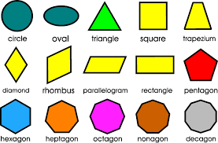
root word - FORM
SHAPE
conform, reform

Slide 23
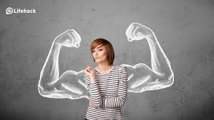
root word - FORT
STRENGTH
fortitude, fortress, fortify

Slide 24
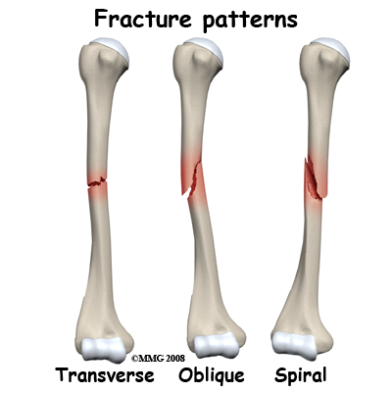
root word - FRACT
BREAK
fracture, fraction

Slide 25
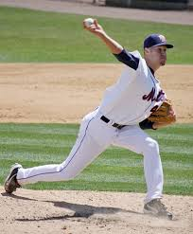
root word – JECT
THROW
projection, rejection

Slide 26
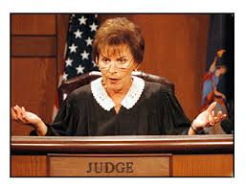
root word - JUD
JUDGE
judicial, prejudice

