Slide 1
Vocabulary Level D
Unit 8

Slide 2
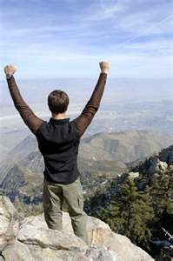
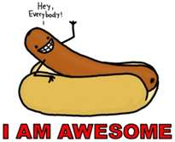
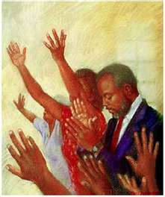
Assurance NOUN
a pledge; freedom from doubt, self-confidence

Slide 3
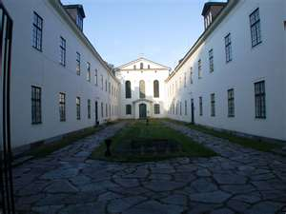
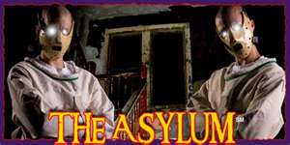
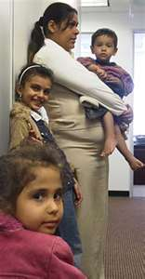
Asylum NOUN
an institution for the care of children, elderly people, etc; a place of safety

Slide 4
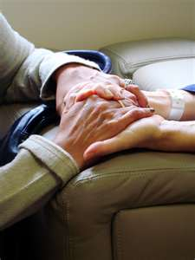
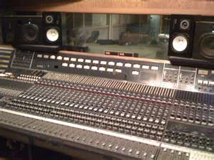
Console VERB & NOUN
v. to comfort
n. the keyboard of an organ; control panel for an electrical or mechanical device

Slide 5
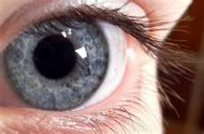
Dilate VERB
to make or become larger or wider; to expand upon

Slide 6
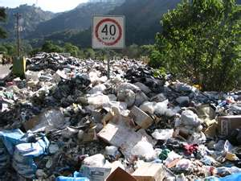
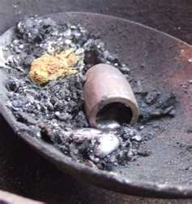
Dross NOUN
refuse, waste products

Slide 7
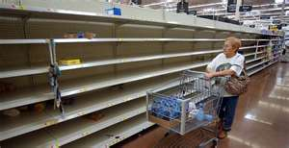
Dwindle VERB
to lessen, diminish

Slide 8
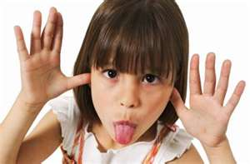
Flippant ADJECTIVE
lacking in seriousness; disrespectful, saucy

Slide 9
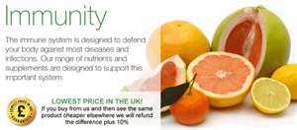
Immunity NOUN
resistance to disease; freedom from some charge or obligation

Slide 10
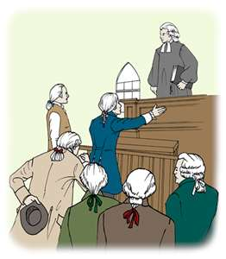
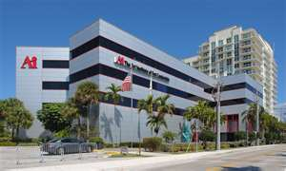
Institute VERB & NOUN
v. to establish, set up; n. an organization for the promotion of learning

Slide 11
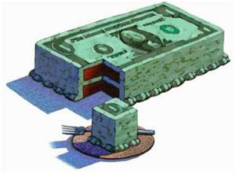
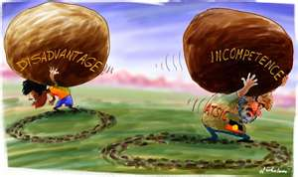
Liability NOUN
a debt; something disadvantageous

Slide 12
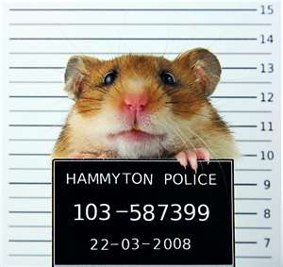
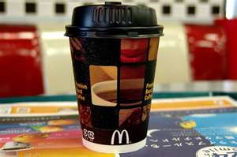
Preposterous ADJECTIVE
ridiculous, senseless
The lawsuit over a hot cup of McDonald’s coffee seemed preposterous to me and ridiculous to an extreme.

Slide 13
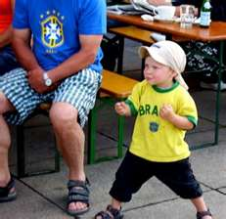
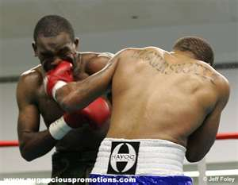
Pugnacious ADJECTIVE
quarrelsome, fond of fighting

Slide 14
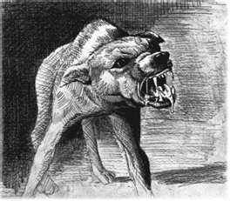
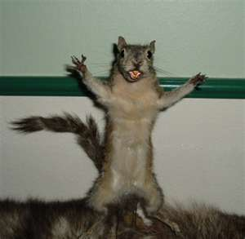
Rabid ADJECTIVE
furious, violently intense, unreasonably extreme, mad, infected with rabies

Slide 15
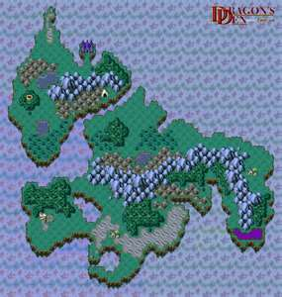
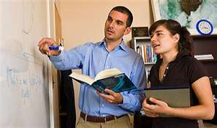
Realm NOUN
a kingdom; a region or field of study

Slide 16
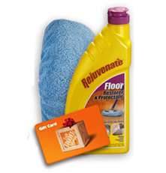
Rejuvenate VERB
to make young again; to make like new

Slide 17
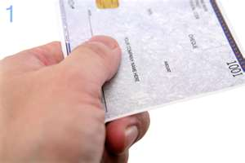
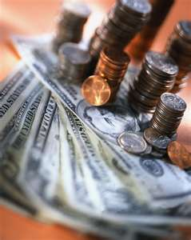
Remunerate VERB
to reward, pay, reimburse

Slide 18
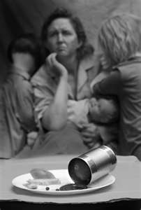
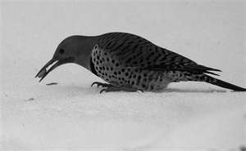
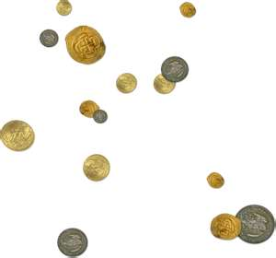
Sparse ADJECTIVE
meager, scant; scattered

Slide 19
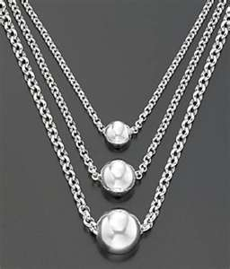
Sterling ADJECTIVE
genuine, excellent; made of silver of standard fineness

Slide 20
Venture NOUN
a risky or daring undertaking; v. to expose to danger; to dare

Slide 21
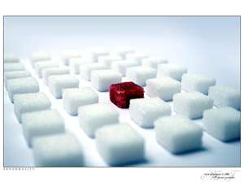
Warp VERB & NOUN
v. to twist out of shape; n. an abnormality

Slide 22
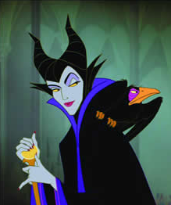
Root word: MAL bad
Malificent
Malefactor

Slide 23
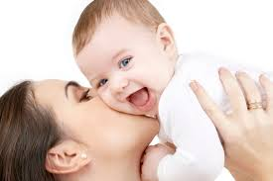
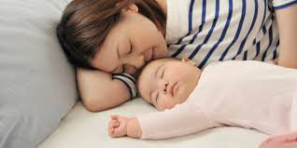
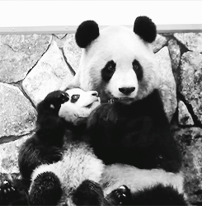
Root word: MATER mother
Maternal
Maternity

Slide 24
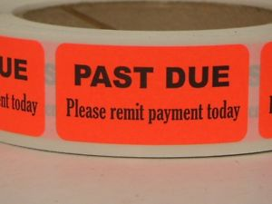
Root word: MIT to send
Transmit
Admit
Remit

Slide 25
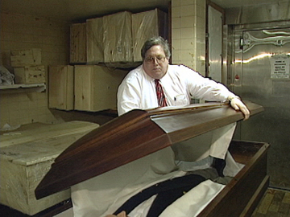
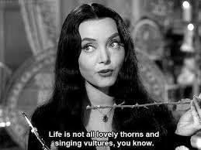
Root word: MORT death
Mortician
Mortal
Immortal

Slide 26
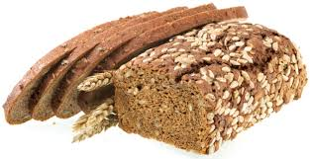
Root word: MULTI many
Multimedia
Multiple
Multi-grain

