Slide 1
Am. Lit. Vocabulary
Level F, Unit 11

Slide 2
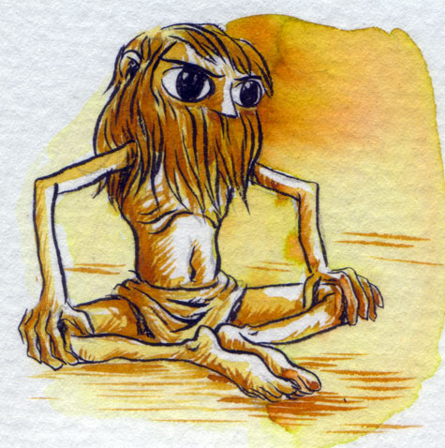
abstemious
(adj.) moderate, sparing (as in eating and drinking); characterized by abstinence and self-discipline
Synonyms: temperate, sober, moderate
Antonyms: indulgent, immoderate, intemperate

Slide 3
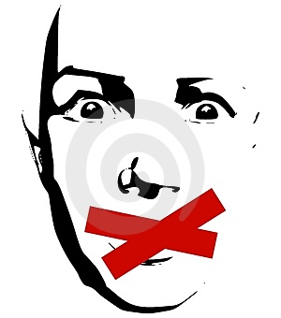
censurable
(adj.) deserving of blame or correction
Synonyms: blameworthy, discreditable, reprehensible
Antonyms: commendable, laudable, meritorious

Slide 4
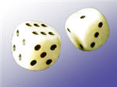
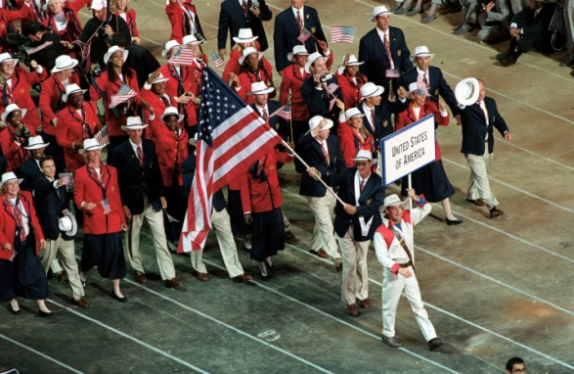
contingent
(adj.) likely but not certain to happen, possible; dependent on uncertain events or conditions; happening by chance; (n.) a representative group forming part of a larger body
Synonyms: (adj.) conditional, dependent; (n.) a detachment
Antonyms: (adj.) independent of, certain

Slide 5
corroborate
(v.) to confirm, make more certain, bolster, substantiate, verify
Antonyms: (adj.) refute, contradict, undermine, discredit

Slide 6
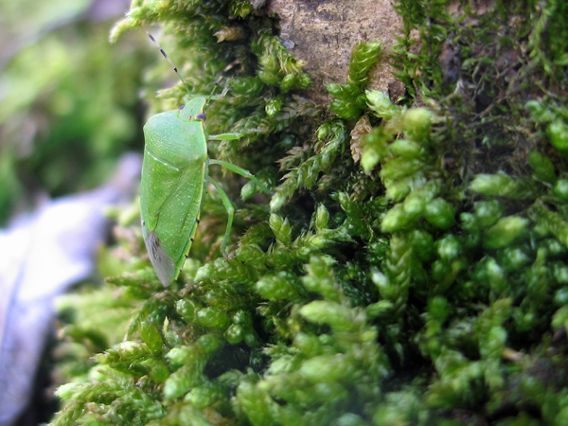
denizen
(n.) an inhabitant, resident; one who frequents a place
Synonyms: resident, dweller, habitué
Antonyms: alien, outsider, stranger, foreigner

Slide 7
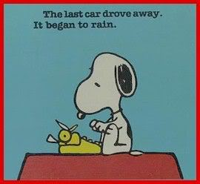
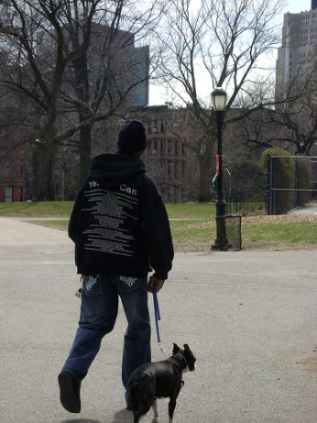
discursive
(adj.) passing aimlessly from one place or subject to another, rambling, roving, nomadic
Synonyms: digressive, diffuse, wandering, episodic
Antonyms: short
and to the point,
succinct

Slide 8
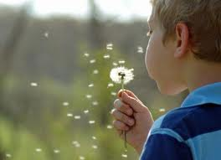
disseminate
(v.) to scatter or spread widely
Synonyms: disperse, publicize, broadcast, circulate
Antonyms: bring together, concentrate, muster, conceal, hide

Slide 9
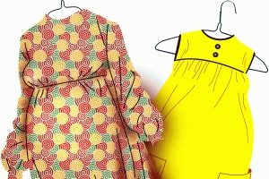
dowdy
(adj.) poorly dressed, shabby; lacking smartness and good taste
Synonyms: frumpy, tacky, frowsy, drab
Antonyms: chic, stylish, elegant, fashionable

Slide 10
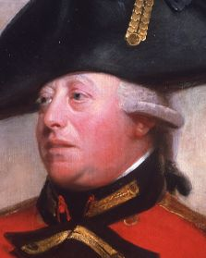
florid
(adj.) highly colored, reddish; excessively ornate, showy
Synonyms: flushed, ruddy, flowery, frilly, flamboyant
Antonyms: pale, ashen, pallid,
sallow, austere, stark

Slide 11
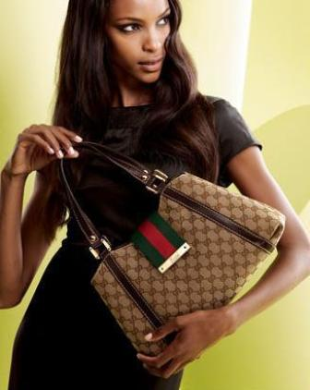
foist
(v.) to impose by fraud; to pass off as worthy or genuine; to bring about by stealth, dishonesty, or coercion
Synonyms: pass off, palm off, fob off

Slide 12
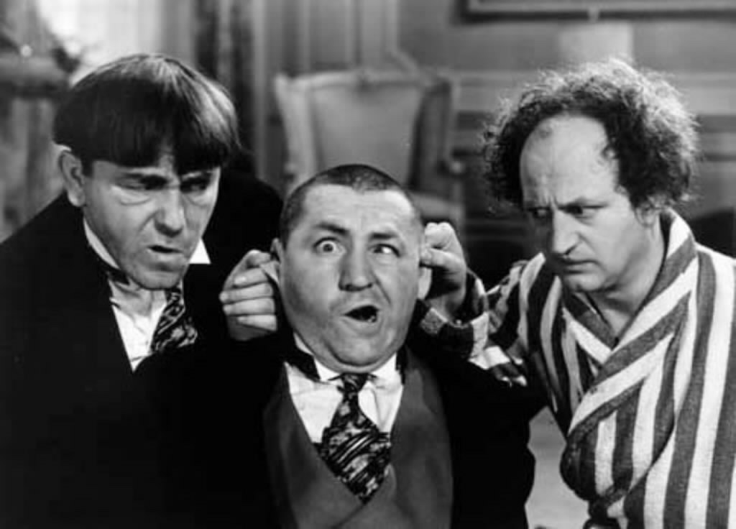
gauche
(adj.) awkward, lacking in social graces, tactless, clumsy
Synonyms: inept, uncouth, maladroit
Antonyms: adroit, tactful, diplomatic, politic

Slide 13
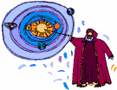
heresy
(n.) an opinion different from accepted belief; the denial of an idea that is generally held sacred
Synonyms: unorthodox belief, heterodoxy
Antonym: orthodoxy

Slide 14
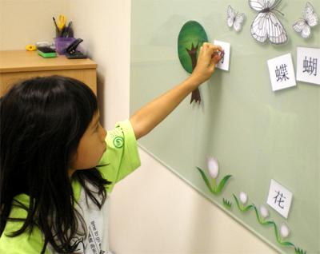
inculcate
(v.) to impress on the mind by repetition, teach persistently and earnestly
Synonyms: instill, implant, infuse, ingrain, imbue
Antonyms: efface, extirpate, root out

Slide 15
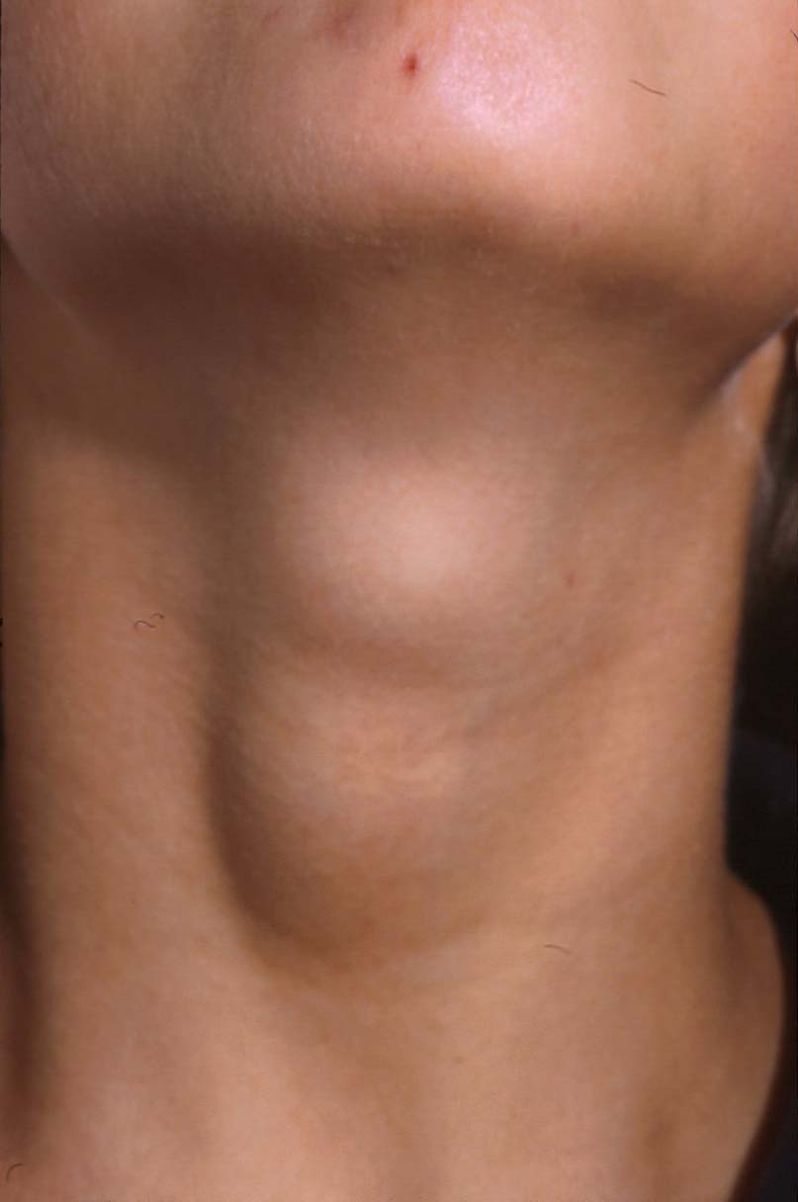
palpable
(adj.) capable of being touched or felt; easily seen, heard, or recognized
Synonyms: tangible, plain, obvious, manifest
Antonyms: intangible,
insubstantial, incorporeal
thyroid nodule

Slide 16
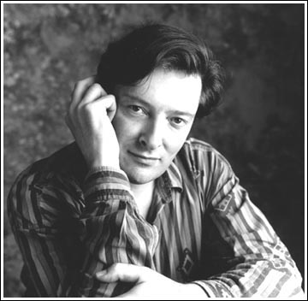
perceptive
(adj.) having sympathetic insight or understanding, capable of keen appreciation
Synonyms: insightful, discerning, observant
Antonyms: dense,
thick, obtuse, dim-witted
Poet Peter Nicholson

Slide 17
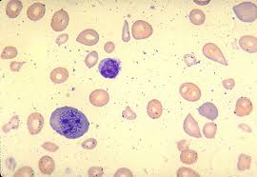
pernicious
(adj.) extremely harmful; deadly, fatal
Synonyms: injurious, deleterious, baleful, noxious
Antonyms: harmless, innocuous, salutary, salubrious
Megaloblastic Anemia

Slide 18
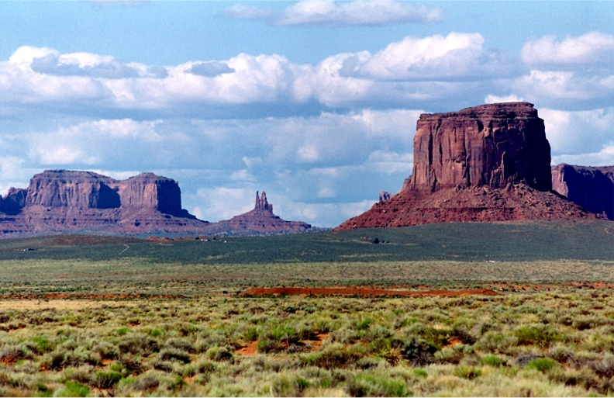
salient
(adj.) leaping, jumping, or springing forth; prominent, standing out, conspicuous; (n.) a projection or bulge, a land form that projects upward or outward
Synonyms: (adj.) striking, notable, protrusive, obvious
Antonyms: (adj.)
inconspicuous, recessive

Slide 19
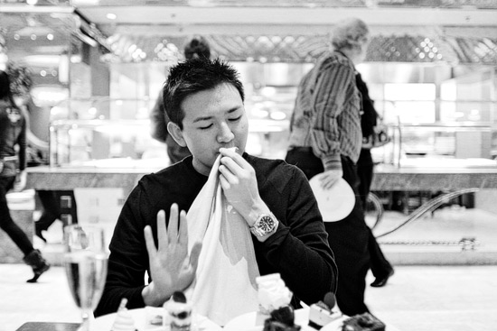
satiate
(v.) to satisfy completely; to fill to excess; (adj.) full, satisfied
Synonyms: (v.) gratify, cloy, surfeit, gorge
Antonyms: (v.) starve, deprive entirely of

Slide 20
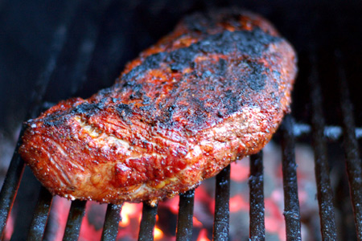
sear
(v.) to make or become dry and withered; to char or scorch the surface of; to harden or make unfeeling; to parch, singe

Slide 21
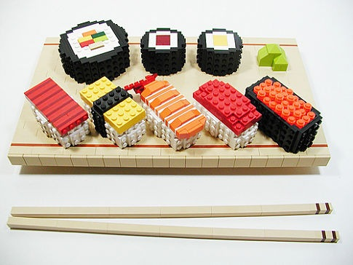
specious
(adj.) deceptive, apparently good or valid but lacking real merit
Synonyms: deceptively plausible, sophistic, casuistic
Antonyms: valid, sound,
solid, genuine

