Slide 1
Am. Lit. Vocabulary
Level F, Unit 12

Slide 2
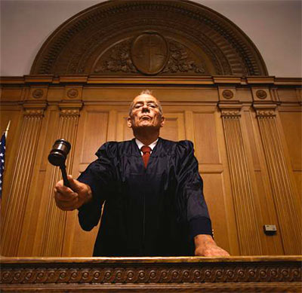
absolve
(v.) to clear from blame, responsibility, or guilt
Synonyms: acquit, exonerate, vindicate, excuse, pardon
Antonyms: condemn, convict, incriminate, inculpate

Slide 3
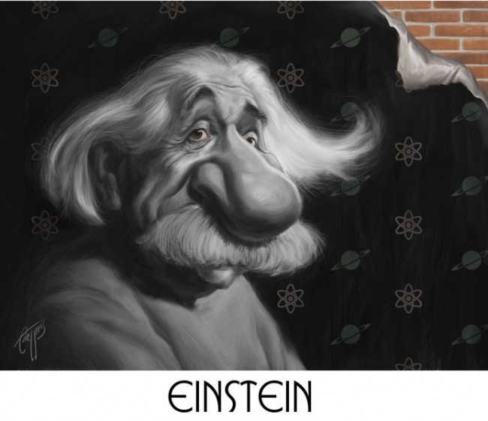
caricature
(n.) a representation (especially a drawing) in which the subject’s characteristic features are deliberately exaggerated; (v.) to present someone or something in a deliberately distorted way
Synonyms: (n.) cartoon, burlesque, parody, lampoon

Slide 4
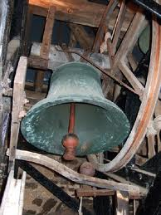
clangor
(n.) a loud ringing sound; (v.) to make a loud ringing noise
Synonyms: (n.) din, clamor, uproar
Antonyms: (n.) silence, stillness, peace and quiet

Slide 5
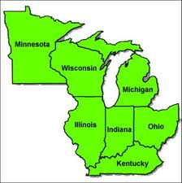
contiguous
(adj.) side by side, touching; near; adjacent in time
Synonyms: adjoining, abutting, next door to
Antonyms: detached, apart, distant, remote

Slide 6
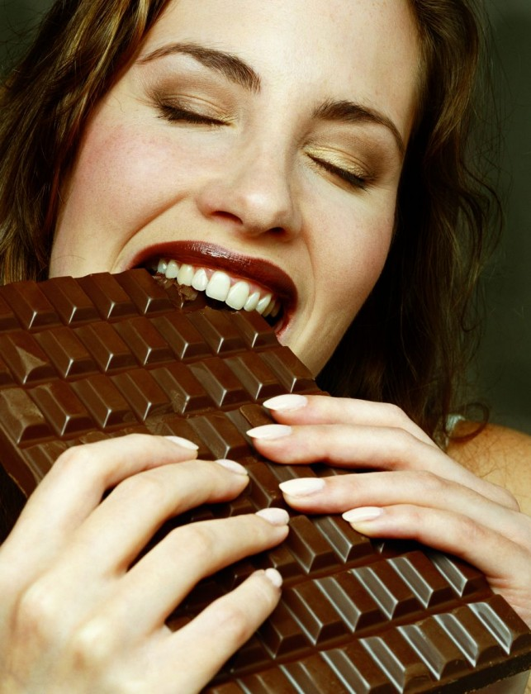
cupidity
(n.) an eager desire for something; greed
Synonyms: avarice, rapacity, craving, lust
Antonyms: generosity, contentment, satiation, gratification

Slide 7
deleterious
(adj.) harmful, injurious
Synonyms: detrimental, destructive, pernicious, damaging
Antonyms: helpful, beneficial, harmless, innocuous

Slide 8
enhance
(v.) to raise to a higher degree; to increase the value or desirability of
Synonyms: improve, magnify, heighten, elevate
Antonyms: diminish, reduce, lessen, degrade

Slide 9
enthrall
(v.) to captivate, charm, hold spellbound; to enslave; to imprison
Synonyms: fascinate, enchant, attract, bewitch
Antonyms: bore to tears, repel, put someone off

Slide 10
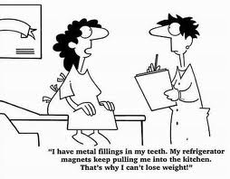
extenuate
(v.) to lessen the seriousness or magnitude of an offense by making partial excuses
Synonyms: moderate, mitigate, diminish, downplay
Antonyms: intensify, aggravate, worsen, exacerbate

Slide 11
implicit
(adj.) implied or understood though unexpressed; without doubts or reservations, unquestioning; potentially contained in
Synonyms: inferred, tacit, unspoken, unconditional
Antonyms: explicit, expressed,
stated, revealed

Slide 12
incisive
(adj.) sharp, keen, penetrating (with a suggestion of decisiveness and effectiveness)
Synonyms: acute, cutting, perceptive, trenchant

Slide 13
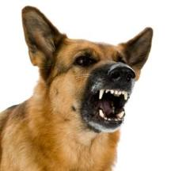
inimical
(adj.) tending to cause harm or obstruct developments; being oppositonal or adverse
Syn – unfriendly, hostile, antagonistic, contrary
Ant – friendly, hospitable, kind

Slide 14
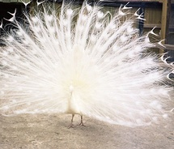
ostentatious
(adj.) marked by conspicuous or pretentious display, showy
Synonyms: flashy, overdone, affected, flamboyant
Antonyms: modest, plain, simple, demure, retiring

Slide 15
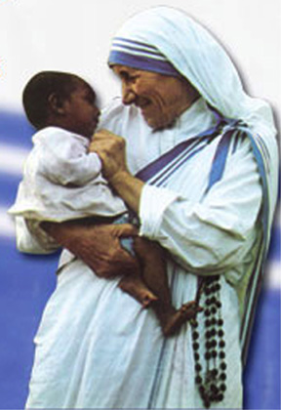
paragon
(n.) a model of excellence or perfection
Synonyms: exemplar, ideal, paradigm, model, good example

Slide 16
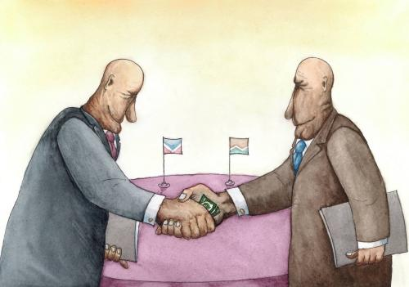
politic
(adj.) prudent, shrewdly conceived and developed; artful, expedient
Synonyms: tactful, diplomatic, judicious, circumspect
Antonyms: unwise, injudicious, imprudent, rash

Slide 17
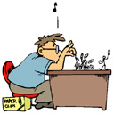
prosaic
(adj.) dull, lacking in distinction and originality; matter-of-fact, straightforward; characteristic of prose, not poetic
Synonyms: commonplace, humdrum literal, pedestrian
Antonyms: remarkable, distinctive, poetic, inspired

Slide 18
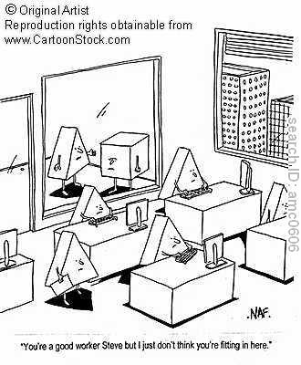
redundant
(adj.) extra, excess, more than is needed; wordy, repetitive; profuse, lush
Synonyms: unnecessary, superfluous, verbose, prolix
Antonyms: succinct, terse, laconic, scarce, inadequate

Slide 19
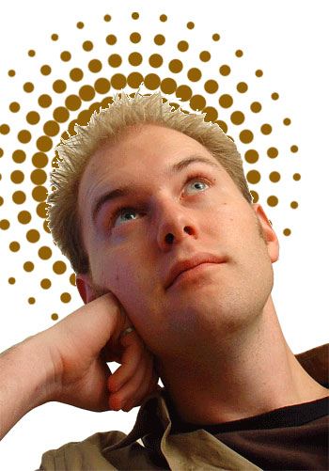
sanctimonious
(adj.) making a show of virtue or righteousness; hypocritically moralistic or pious, self-righteous, canting, holier-than-thou
Antonyms: heartfelt, sincere,
humble

Slide 20
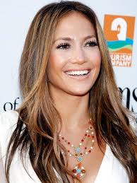
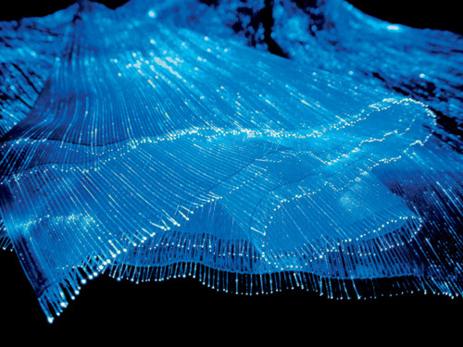
scintillating
(adj., part.) sparkling, twinkling, exceptionally brilliant (applied to mental or personal qualities)
Synonyms: stimulating, lively, glittering, flashing
Antonyms: dull, boring, insipid, flat, tame, vapid

Slide 21
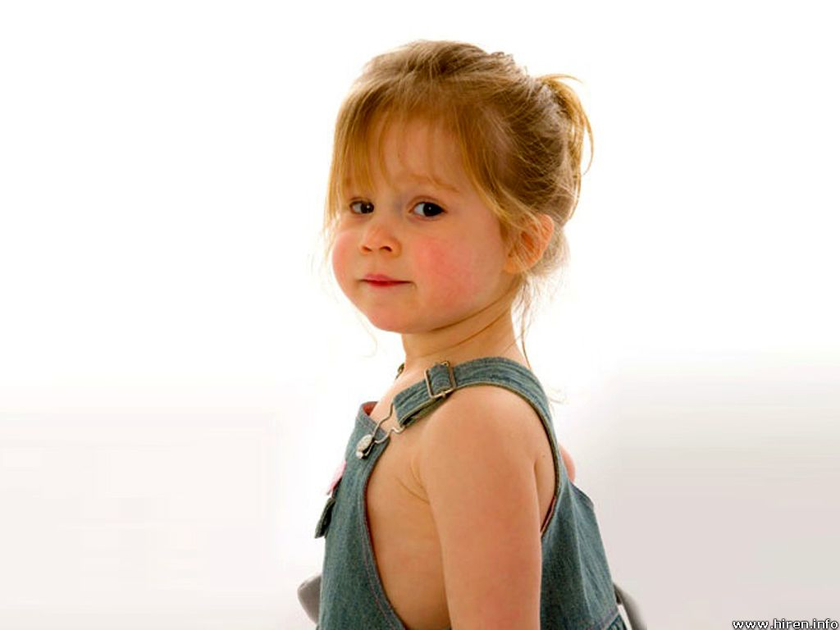
winsome
(adj.) charming, attractive, pleasing (often suggesting a childlike charm and innocence)
Synonyms: winning, engaging, delightful, prepossessing
Antonyms: unattractive, unappealing, repulsive

