Slide 1
Am. Lit. Vocabulary
Level F, Unit 13

Slide 2
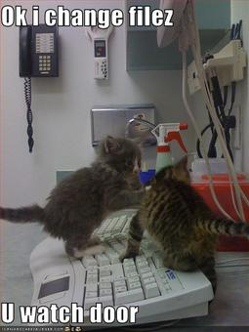
abet
(v.) to encourage, assist, aid, support (especially in something wrong or unworthy)
Antonyms: hamper, hinder, impede, frustrate

Slide 3
aver
(v.) to affirm, declare confidently
Synonyms: assert, asseverate, avouch
Antonyms: deny, disavow, repudiate, disclaim

Slide 4
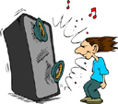
blatant
(adj.) noisy in a coarse, offensive way; obvious or conspicuous, especially in an unfavorable sense
Synonyms: flagrant, glaring, egregious, disagreeably loud
Antonyms: inconsequential,
trifling, piddling, petty

Slide 5
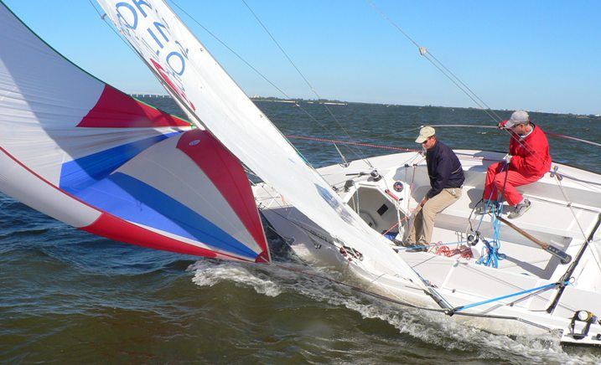
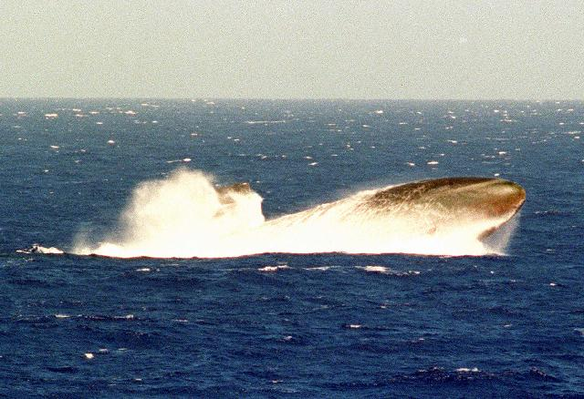
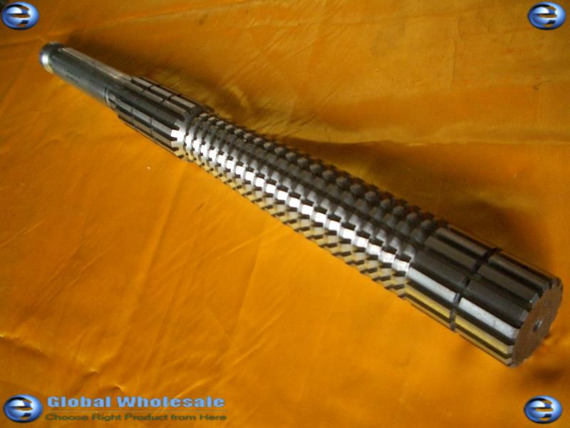
broach
(v.) to bring up or begin to talk about a subject; to announce, introduce; to break the surface of the water; to turn sideways to the wind and waves; to pierce a keg or cask in order to draw off liquid; (n,) a spit for roasting; a tool for tapping casks

Slide 6
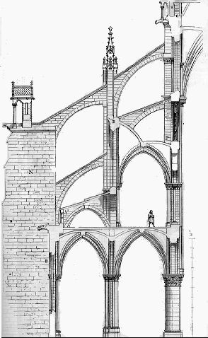
buttress
(v.) to support, prop up, strengthen; (n.) a supporting structure
Synonyms: (v.) bolster, reinforce, brace, shore up
Antonyms: (v.) undermine,
weaken, impair

Slide 7
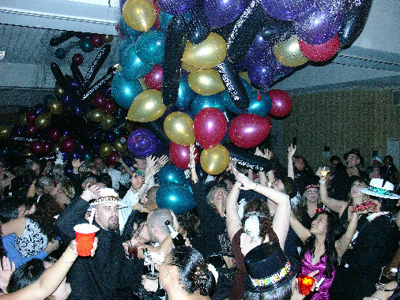
carousal
(n.) noisy revelry or merrymaking (often with a suggestion of heavy drinking)
Synonyms: drinking bout, drunken revel, binge

Slide 8
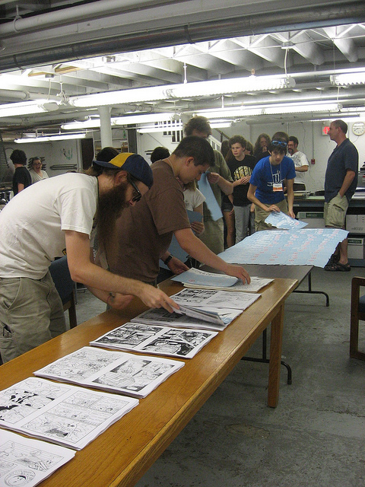
collate
(v.) to compare critically in order to note differences, similarities, etc.; to arrange in order for some specific purpose
Synonyms: sort out, cross-check, rearrange

Slide 9
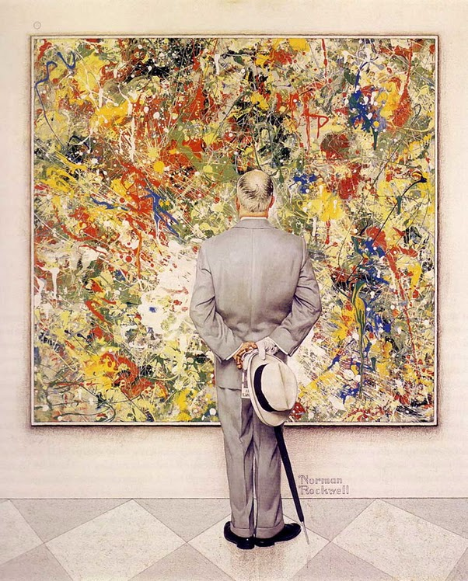
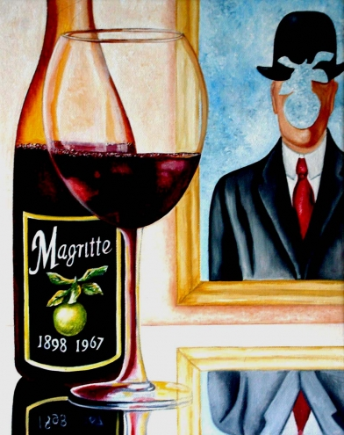
connoisseur
(n.) an expert; one who is well qualified to pass critical judgments, especially in one of the fine arts
Synonyms: authority, savant, pundit
Antonyms: ignoramus,
philistine, yahoo

Slide 10
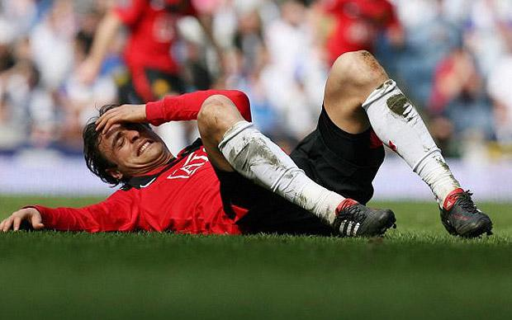
disconsolate
(adj.) deeply unhappy or dejected; without hope, beyond consolation
Synonyms: grief-stricken, inconsolable, comfortless
Antonyms: cheerful, blithe,
buoyant, jaunty

Slide 11
encumber
(v.) to weigh down or burden (with difficulties, cares, debt, etc.); to fill up, block up, hinder
Synonyms: overload, saddle, hamper, clog
Antonyms: unburden, unload,
relieve

Slide 12
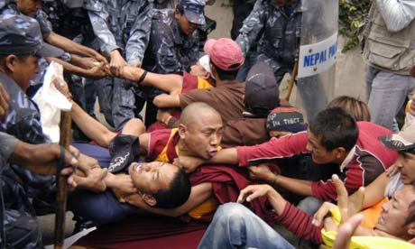
foment
(v.) to promote trouble or rebellion; to apply warm liquids to, warm
Synonyms: instigate, incite, stir up
Antonyms: quell, quash, squelch,
suppress

Slide 13
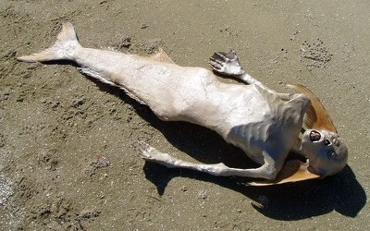
grisly
(adj.) frightful, horrible, ghastly
Synonyms: gruesome, gory, hideous
Antonyms: pleasant, delightful,
attractive

Slide 14
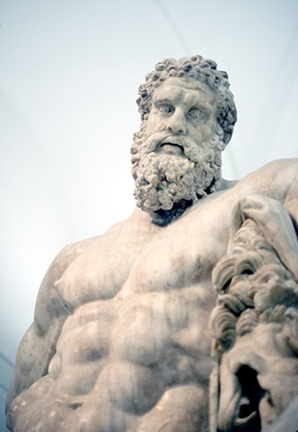
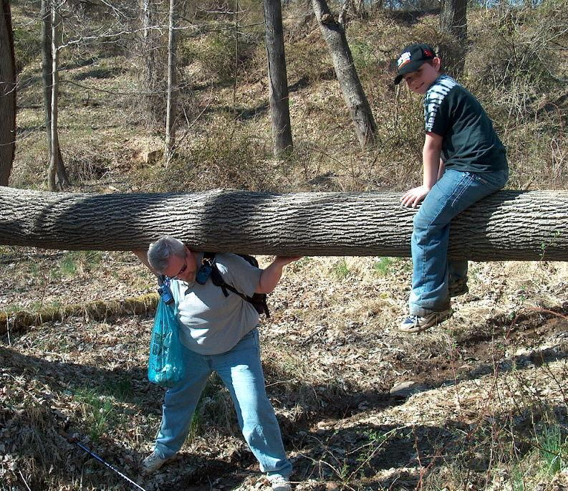
herculean
(adj.) (capital H) relating to Hercules; (lower case h) characterized by great strength; very hard to do in the sense of requiring unusual strength
Synonyms: mighty, powerful,
arduous, onerous, colossal
Antonyms: puny, Lilliputian,
bantam

Slide 15
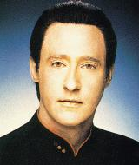
impassive
(adj.) showing no feeling or emotion; inanimate; motionless
Synonyms: emotionless, stoical, unemotional, insensible
Antonyms: emotional,
passionate, excitable

Slide 16
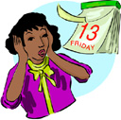
inauspicious
(adj.) unfavorable, unlucky, suggesting bad luck for the future
Synonyms: unpropitious, unpromising, untimely
Antonyms: propitious, favorable

Slide 17
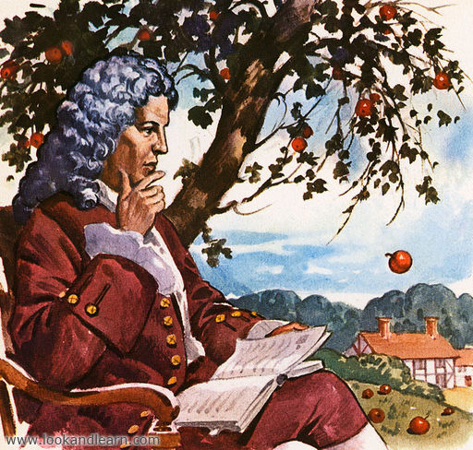
incontrovertible
(adj.) unquestionable, beyond dispute
Synonyms: incontestable, indisputable, indubitable
Antonyms: debatable, dubious,
open to question
Isaac Newton discovers gravity

Slide 18
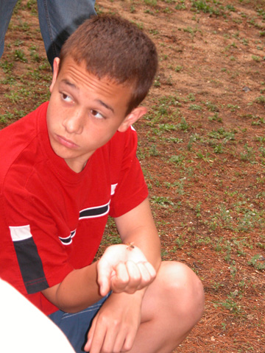
nonplussed
(adj., part.) puzzled, not knowing what to do, at a loss
Synonyms: perplexed, baffled, stumped, flabbergasted
Antonyms: poised, confident,
assured
“You sure these don’t sting?”

Slide 19
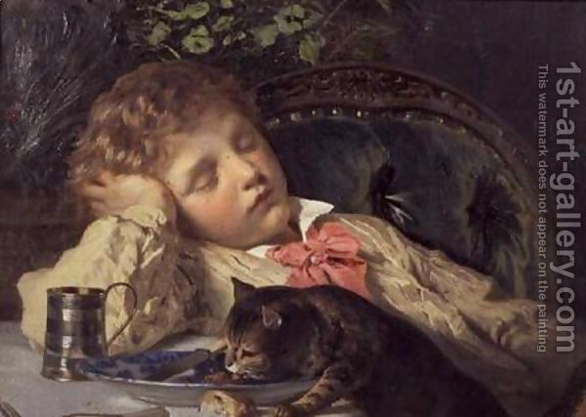
opportune
(adj.) suitable or convenient for a particular purpose; occurring at an appropriate time
Synonyms: timely, appropriate, felicitous
Antonyms: untimely, inconvenient, inappropriate

Slide 20
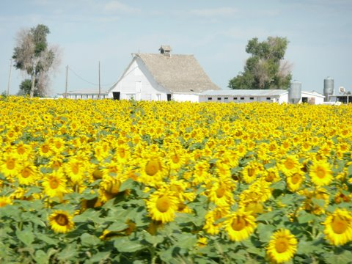
prolific
(adj.) abundantly productive; abundant, profuse
Synonyms: fruitful, fecund, proliferous
Antonyms: barren, unproductive, sterile, sparse

Slide 21
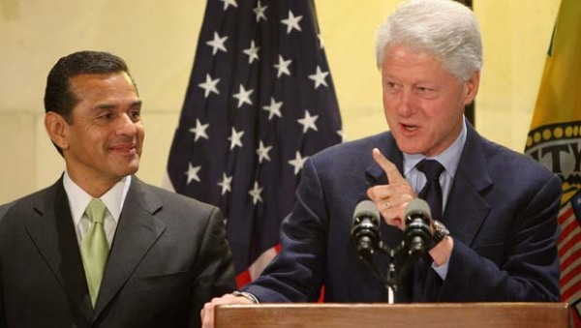
rejoinder
(n.) a reply to a reply, especially from the defendant in a legal suit
Synonyms: answer, reply; response, riposte, retort

