Slide 1
Vocabulary Unit 15
Last one for the semester!
Level F

Slide 2
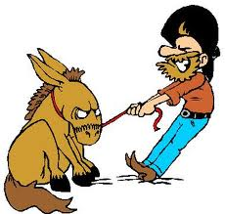
adamant
(adj.) firm in purpose or opinion, unyielding, obdurate, inflexible

Slide 3
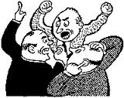
brouhaha
(n.) a confused hodgepodge of sounds, hubbub; an uproar or commotion that goes far beyond what is justified

Slide 4
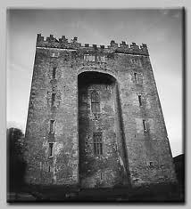
bulwark
(n.) a strong defense or protection, a solid wall-like structure for defense

Slide 5
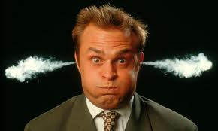
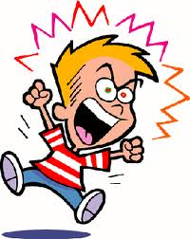
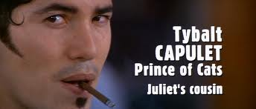
choleric
(adj.) easily made angry, bad-tempered

Slide 6
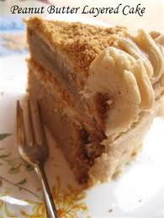
cloy
(v.) to spoil or destroy an appetite by too much indulgence, especially in sweet or rich things

Slide 7
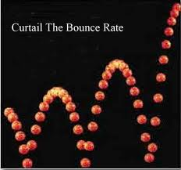
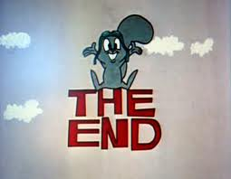
curtail
(v.) to cut short, bring to a halt or end sooner than expected

Slide 8
deference
(n.) courteous yielding to the wishes and ideas of another person; great respect marked by submission, as to a superior

Slide 9
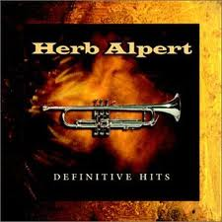
definitive
(adj.) conclusive, final, representing the limit of what can be done

Slide 10
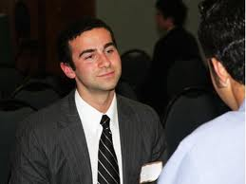
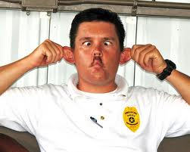
demeanor
(n.) the way a person behaves, overall impression made by comportment, manner

Slide 11
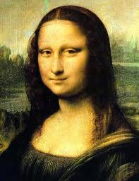
enigmatic
(adj.) puzzling, perplexing

Slide 12
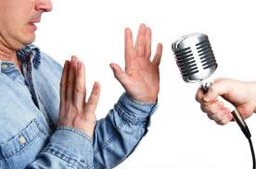
impromptu
(adj., adv.) without preparation, offhand

Slide 13
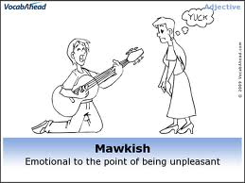
mawkish
(adj.) excessively and objectionable sentimental; having a mildly sickening flavor

Slide 14
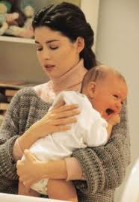
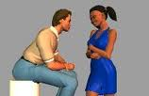
mollify
(v.) to soften, make gentle, pacify; to calm

Slide 15
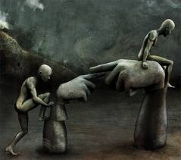
onus
(n.) something that is heavy or burdensome; a stigma, blame

Slide 16
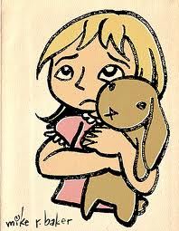
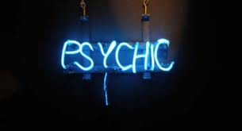
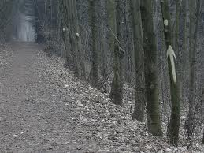
presentiment
(n.) a vague sense of approaching misfortune

Slide 17
profligate
(adj.) given over to self-indulgence, immoral; recklessly extravagant

Slide 18
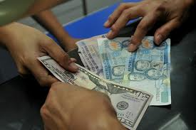
remit
(v.) to end or hand in (as money); to cancel (as a penalty or punishment)

Slide 19
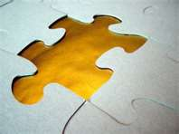
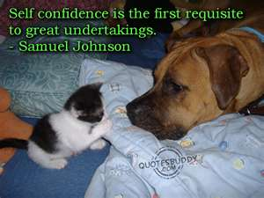
requisite
(adj.) needed, necessary, regarded as essential or indispensable

Slide 20
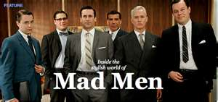
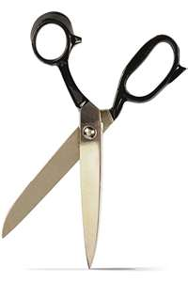
sartorial
(adj.) of or pertaining to a tailor or his work; having to do with clothes or dress (especially men’s)

Slide 21
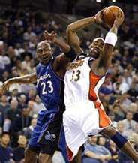
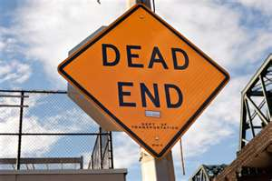
thwart
(v.) to oppose successfully; to prevent, frustrate

