Slide 1
Vocabulary Unit 9 Level F

Slide 2
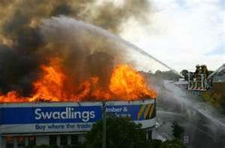
abate
V. – to make less in amount, degree
Below – waiting for the fire to abate

Slide 3
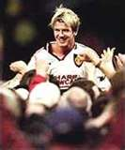
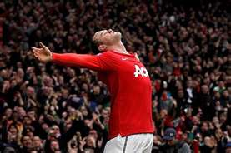
adulation
N. – praise or flattery that is excessive

Slide 4
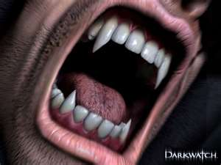
anathema
N. – an object of intense dislike; a curse

Slide 5
astute
Adj. – shrewd, crafty, showing practical wisdom

Slide 6
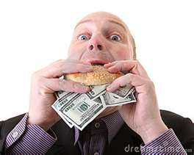
avarice
N. – a greedy desire, particularly for wealth

Slide 7
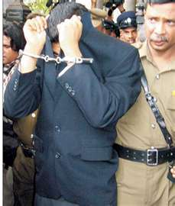
culpable
Adj. – deserving blame

Slide 8
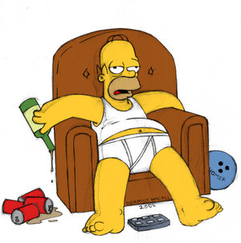
dilatory
Adj. – tending to delay or procrastinate

Slide 9
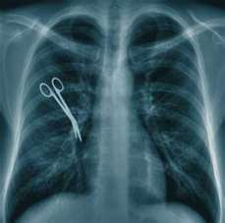
egregious
Adj. – conspicuous, standing out from the mass (usually unfavorable in tone)
Below – an egregious surgeon’s error

Slide 10
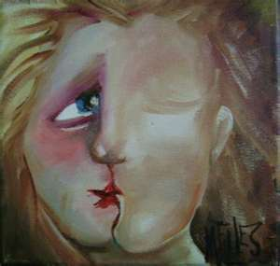
equivocate
V. – to speak or act in a way that allows for more than one interpretation; to be deliberately vague or ambiguous

Slide 11
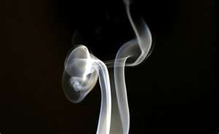
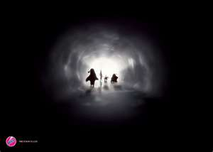
evanescent
Adj. – vanishing, soon passing away; light and airy

Slide 12
irresolute
Adj. – unable to make up one’s mind, hesitating

Slide 13
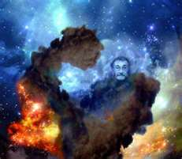
nebulous
Adj. – cloudlike, resembling a cloud; cloudy in color; vague, confused

Slide 14
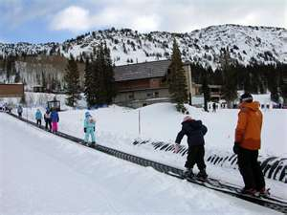
novice
N. – one who is just a beginner at some activity requiring skill
Below – novice skiers start on the bunny slopes

Slide 15
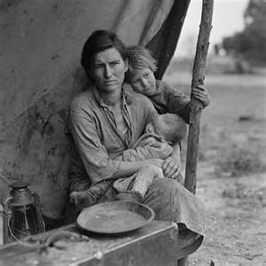
penury
N. – extreme poverty

Slide 16
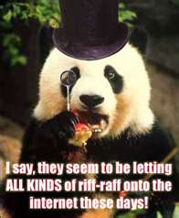
pretentious
Adj. – done for show, striving to make a big impression (usually negative in connotation)

Slide 17
recapitulate
V. – to review a series of facts; to sum up

Slide 18
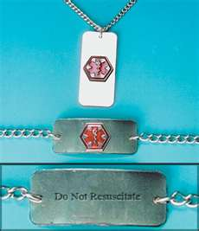
resuscitate
V. – to revive, bring back to consciousness

Slide 19
slovenly
Adj. – untidy, dirty, careless

Slide 20
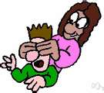
supposition
N. – something that is assumed or taken for granted without conclusive evidence

Slide 21
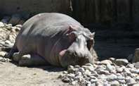
torpid
Adj. – inactive, sluggish, dull

